Slide 1

Application Insights telemetry for Business Central Partners
“It’s as simple as 1, 2, 3”
Notes:
Photo: https://www.pexels.com/photo/brown-firewood-122588/

Slide 2
In this presentation, you will learn about…
What is Azure Application Insights?
Azure Application Insights for partners (end to end)
Setup
Discover
Visualize, monitor, and alert
Troubleshoot using telemetry
New skills needed
What signal is currently available?

Slide 3
Telemetry is just a fancy word for “usage data”
Data
Insights
Actions

Slide 4

What is Azure Monitor (Application Insights)?
Notes:
https://docs.microsoft.com/en-us/azure/azure-monitor/overview

Slide 5

Main use cases for Business Central partners
Setup
Monitor
Troubleshoot
Mitigate
Notes:
Picture: https://www.pexels.com/photo/photo-of-woodpile-1787035/

Slide 6
Characteristics of partner telemetry
Treated as an API
Discoverable in docs
Documented in docs
Actionable
(if possible)

Slide 7
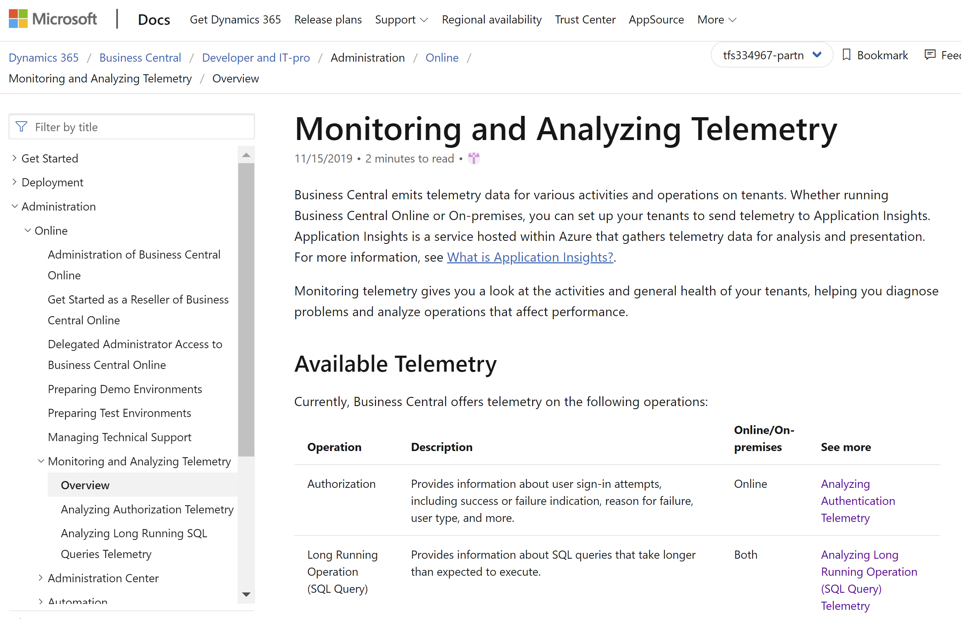
Landing page in docs aka.ms/bctelemetry
Notes:
https://docs.microsoft.com/en-us/dynamics365/business-central/dev-itpro/administration/telemetry-overview
or aka.ms/bctelemetry

Slide 8
It’s as simple as 1, 2, 3
Set up AppInsights for one or more environments
1
Deploy Power BI apps from Appsource
2
Monitor your environments
3
Notes:
High-level takeaway

Slide 9
To get telemetry, you need to do two things
Create an Application Insights resource in Azure
Configure Online Business Central environments in the Tenant Admin Center, or
Configure On-premises Business Central environments using Powershell cmdlets, or
Configure your Business Central app in the app.json manifest file

Slide 10
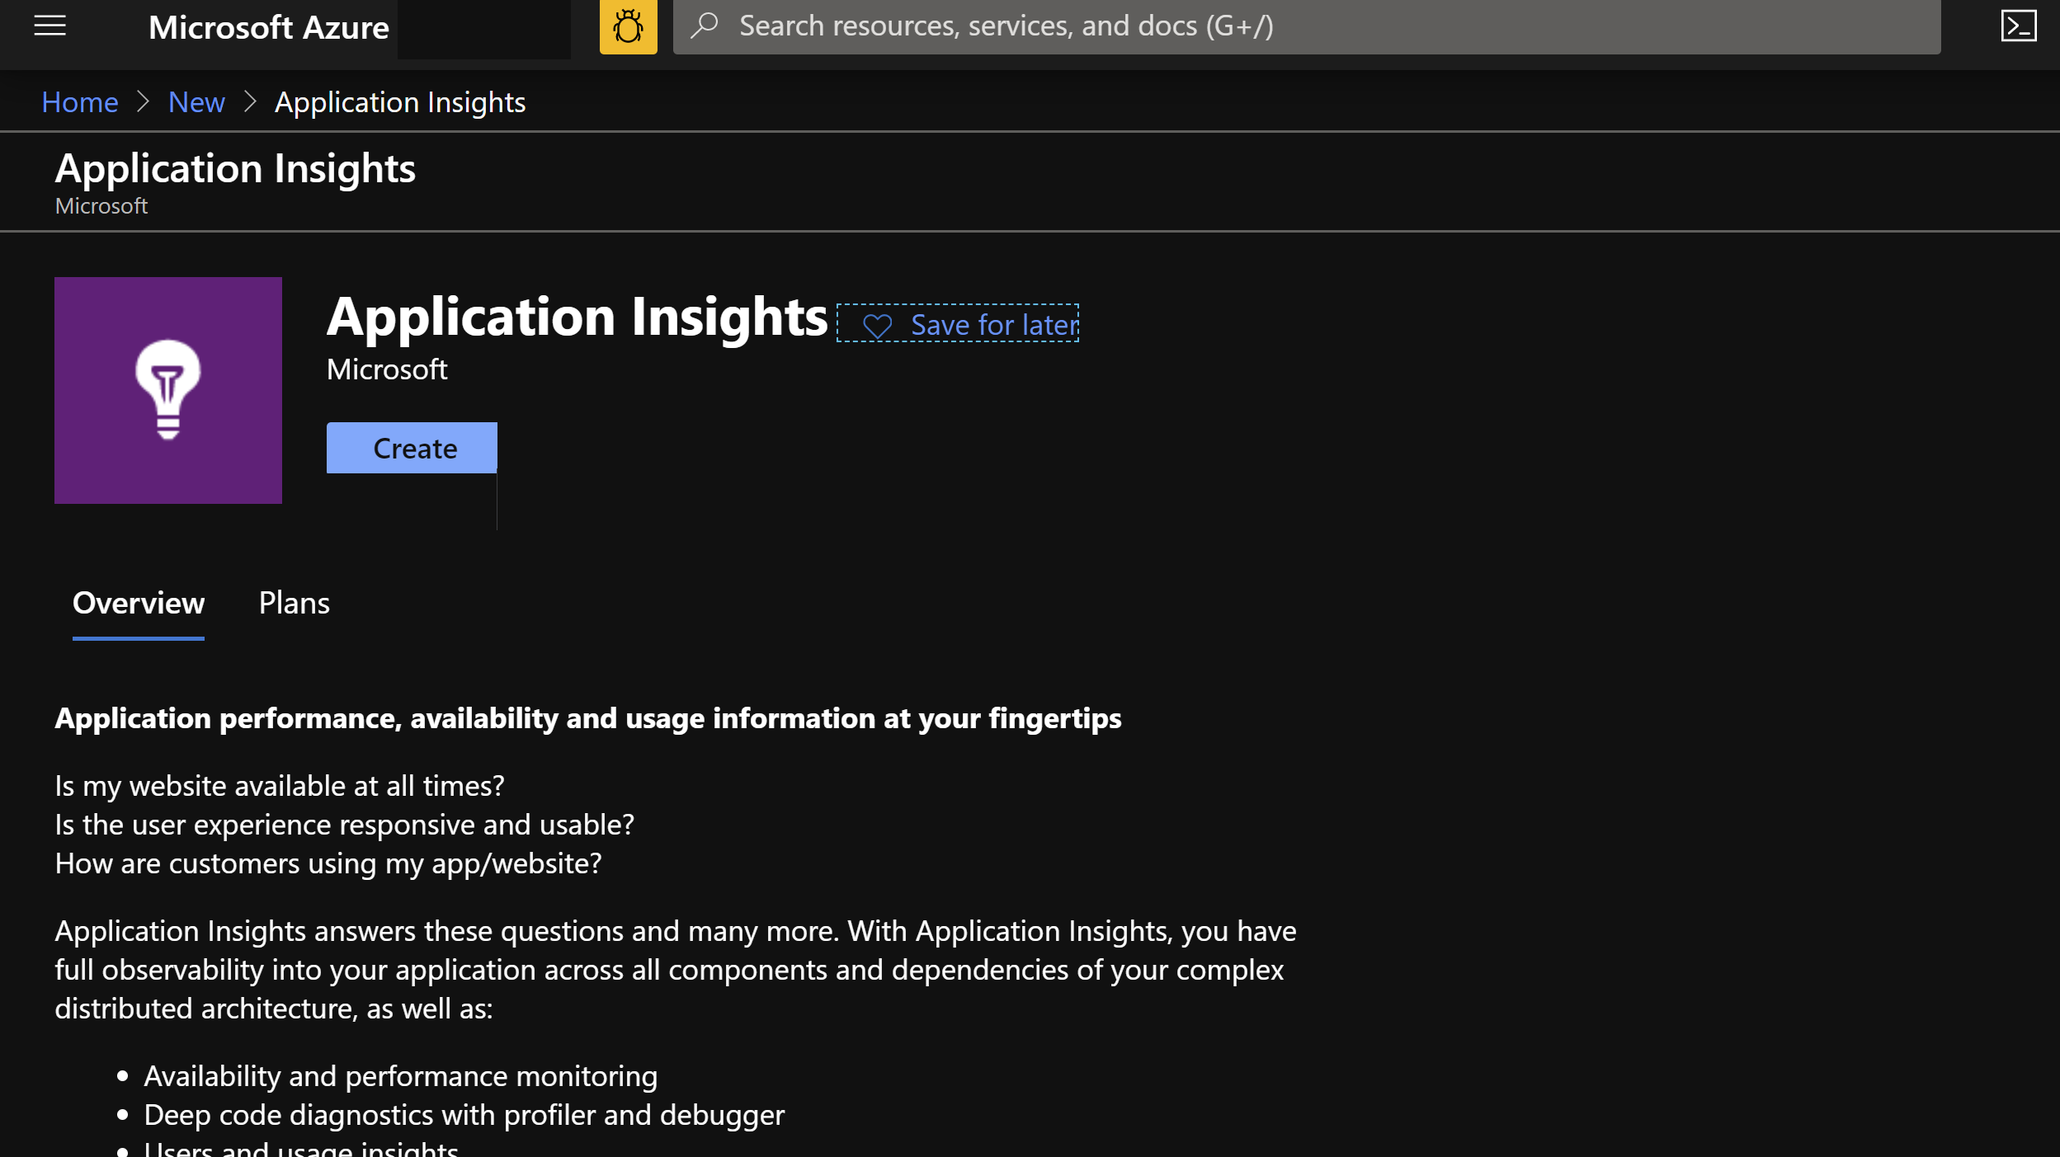

Slide 11
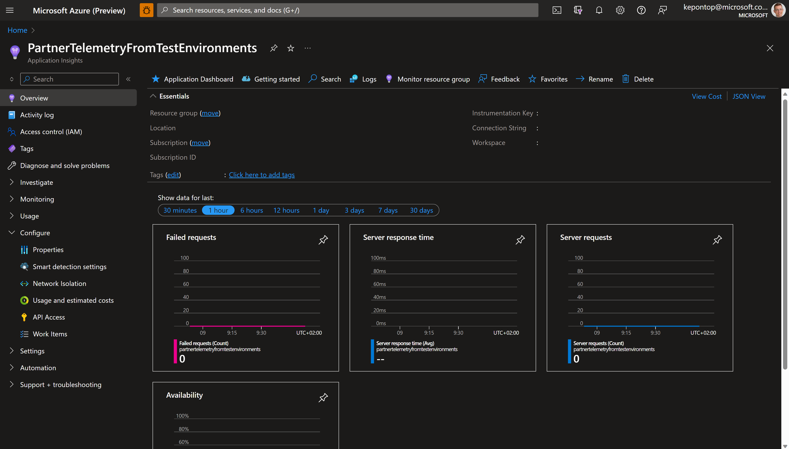
You need to copy this

Slide 12
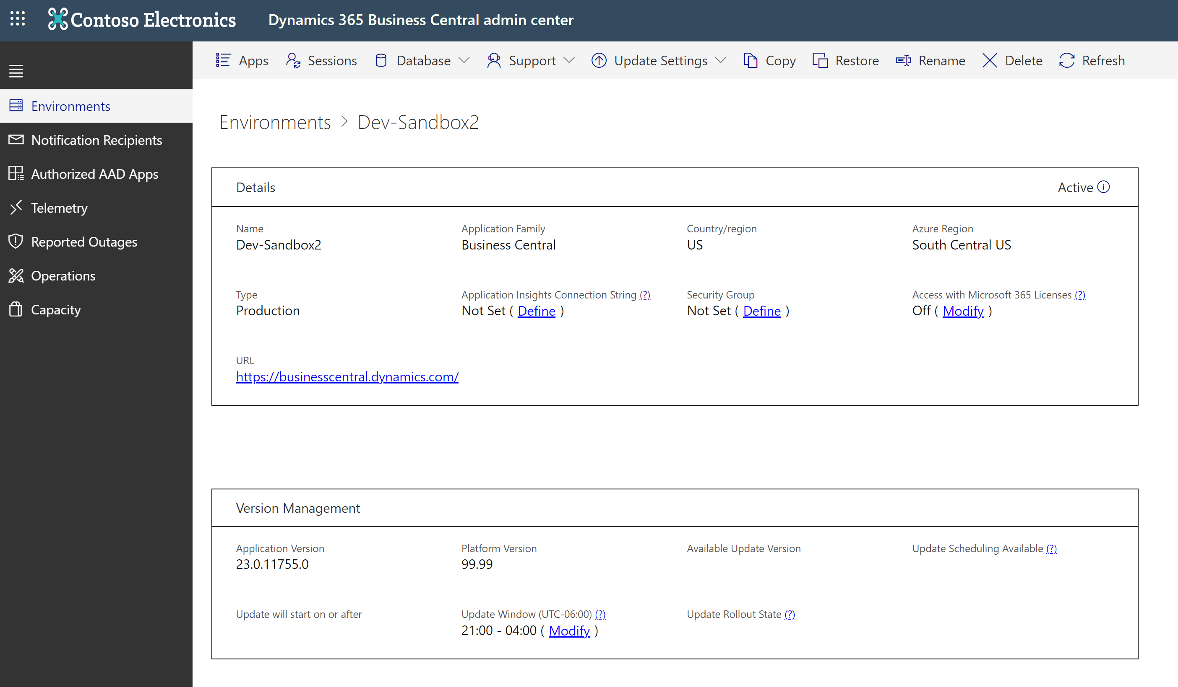
Notes:
App Insights Connection string is per environment. This is BYO (Bring Your Own) AppInsights
See
https://docs.microsoft.com/en-us/dynamics365/business-central/dev-itpro/administration/tenant-admin-center-telemetry#sending-telemetry-to-microsoft-azure-application-insights

Slide 13
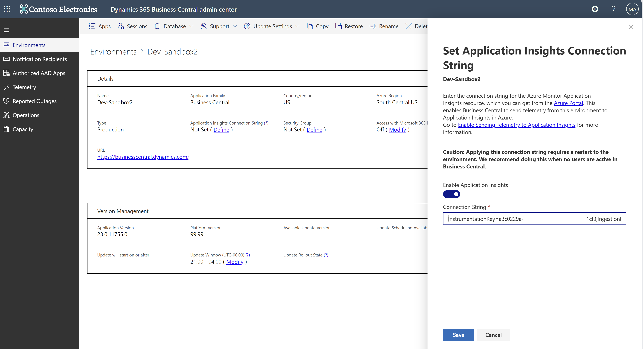
Notes:
Caution: will require a tenant environment restart. Do it off-hours (will cancel all sessions), takes 1-2 minutes to get the environment back online

Slide 14
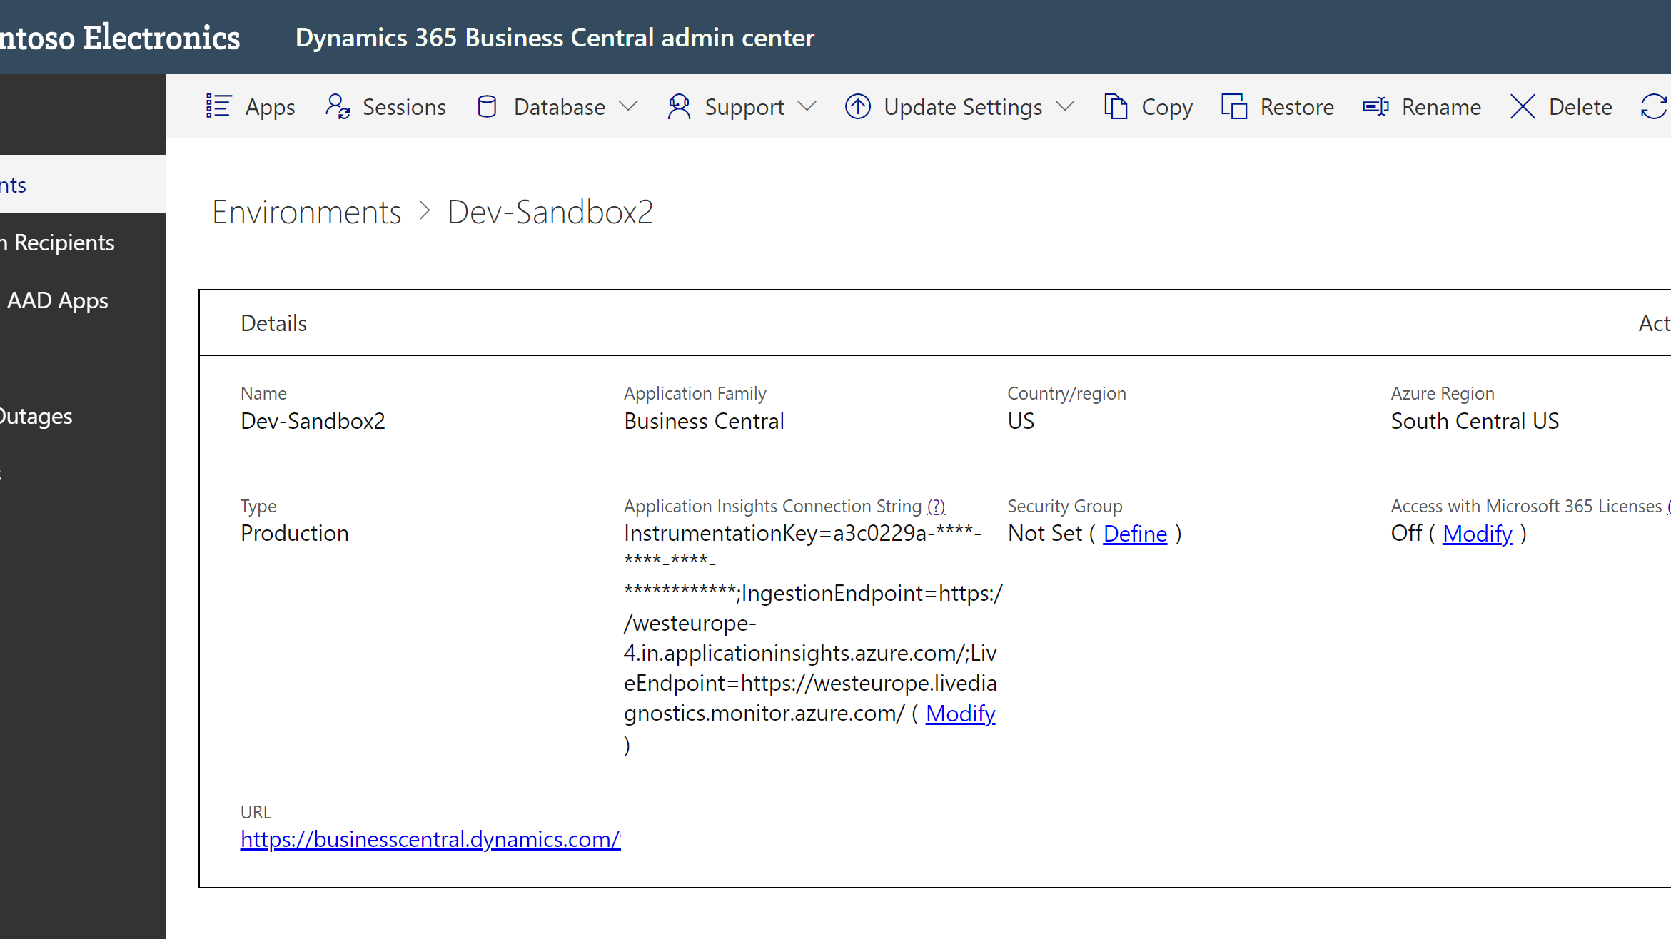
Notes:
Now the instrumentation key is registered with the application servers (NSTs)

Slide 15
Works also on-prem
Use Powershell cmdlets to inject Application Insights key into the NST
Single Tenant mode (2019 release wave 2, version 16.1)
Set-NAVServerConfiguration
-KeyName ApplicationInsightsInstrumentationKey -KeyValue <guid>
-ApplyTo All -ServerInstance <instance name>
Multi Tenant mode (2019 release wave 2, version 16.0)
Mount-NAVTenant -AadTenantId <aad guid>
-DatabaseName <database name> -Id <tenant id>
-DisplayName <tenant name>
-ApplicationInsightsKey <guid>
Notes:
See
https://docs.microsoft.com/en-us/dynamics365/business-central/dev-itpro/administration/telemetry-enable-application-insights

Slide 16
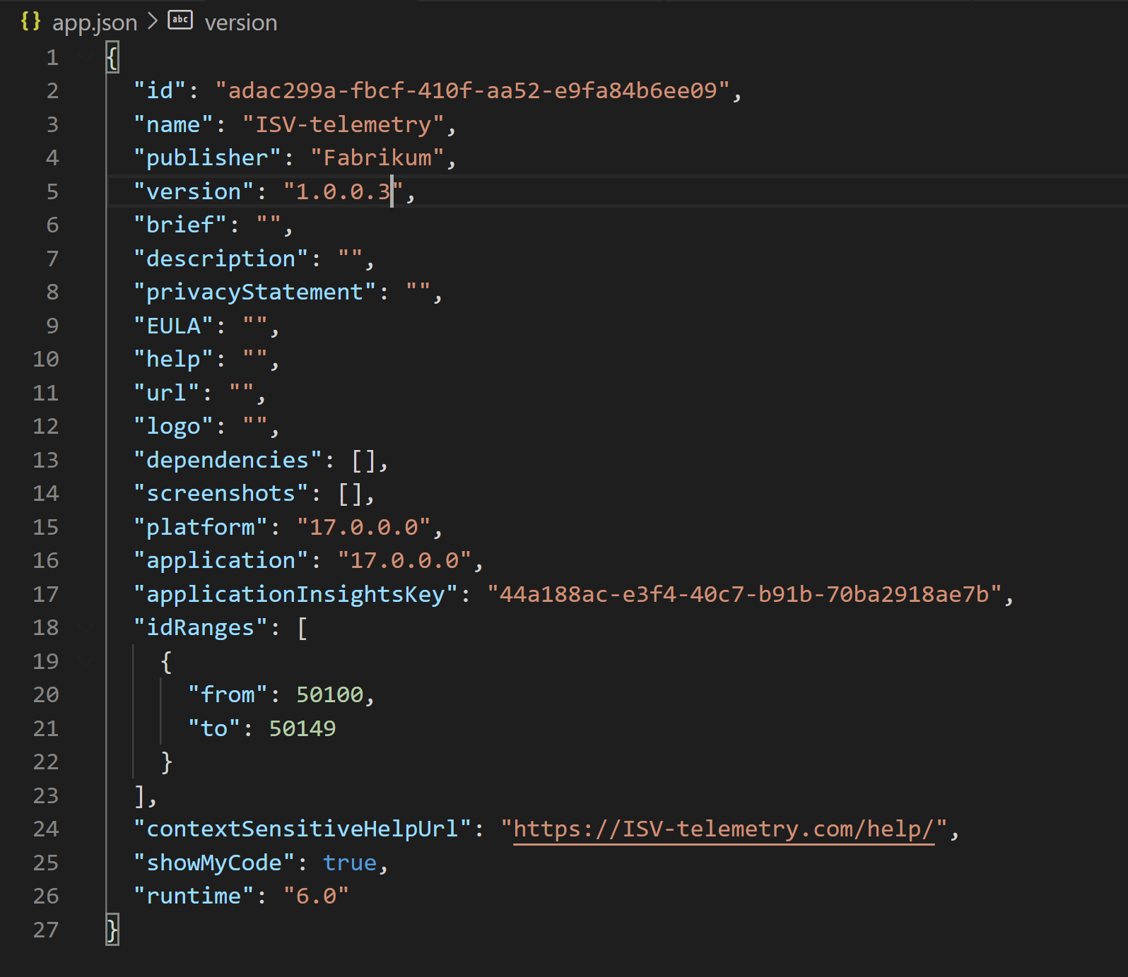
How to setup telemetry for an app

Slide 17

Setup scenarios for partners
One Application Insights account can be used for many environments.
Imagine a partner managing 100 environments for 40 different customers.
Maybe one Application Insights for prod, one for sandboxes
Or select customers want to use their own
Notes:
Picture: https://www.pexels.com/photo/assortment-black-and-white-black-and-white-chrome-220639/

Slide 18
How to visualize data from Application Insights
Use Azure dashboards
https://docs.microsoft.com/en-us/azure/azure-monitor/learn/tutorial-app-dashboards#add-logs-analytics-query
Use PowerBI
https://docs.microsoft.com/en-us/azure/azure-monitor/app/export-power-bi
Use Azure Data Studie (Jupyter notebooks)
https://docs.microsoft.com/en-us/azure/data-explorer/kqlmagic
Notes:
https://docs.microsoft.com/en-us/azure/azure-monitor/learn/tutorial-app-dashboards#add-logs-analytics-query

Slide 19
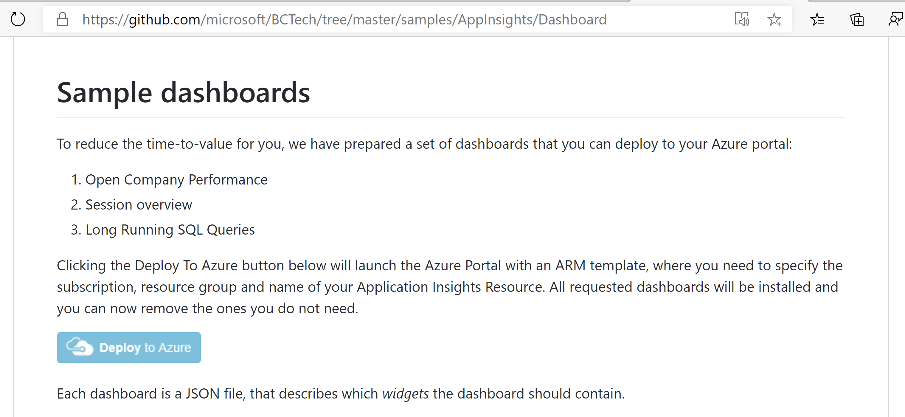
How to deploy sample dashboards
Notes:
https://github.com/microsoft/BCTech/tree/master/samples/AppInsights/Dashboard

Slide 20
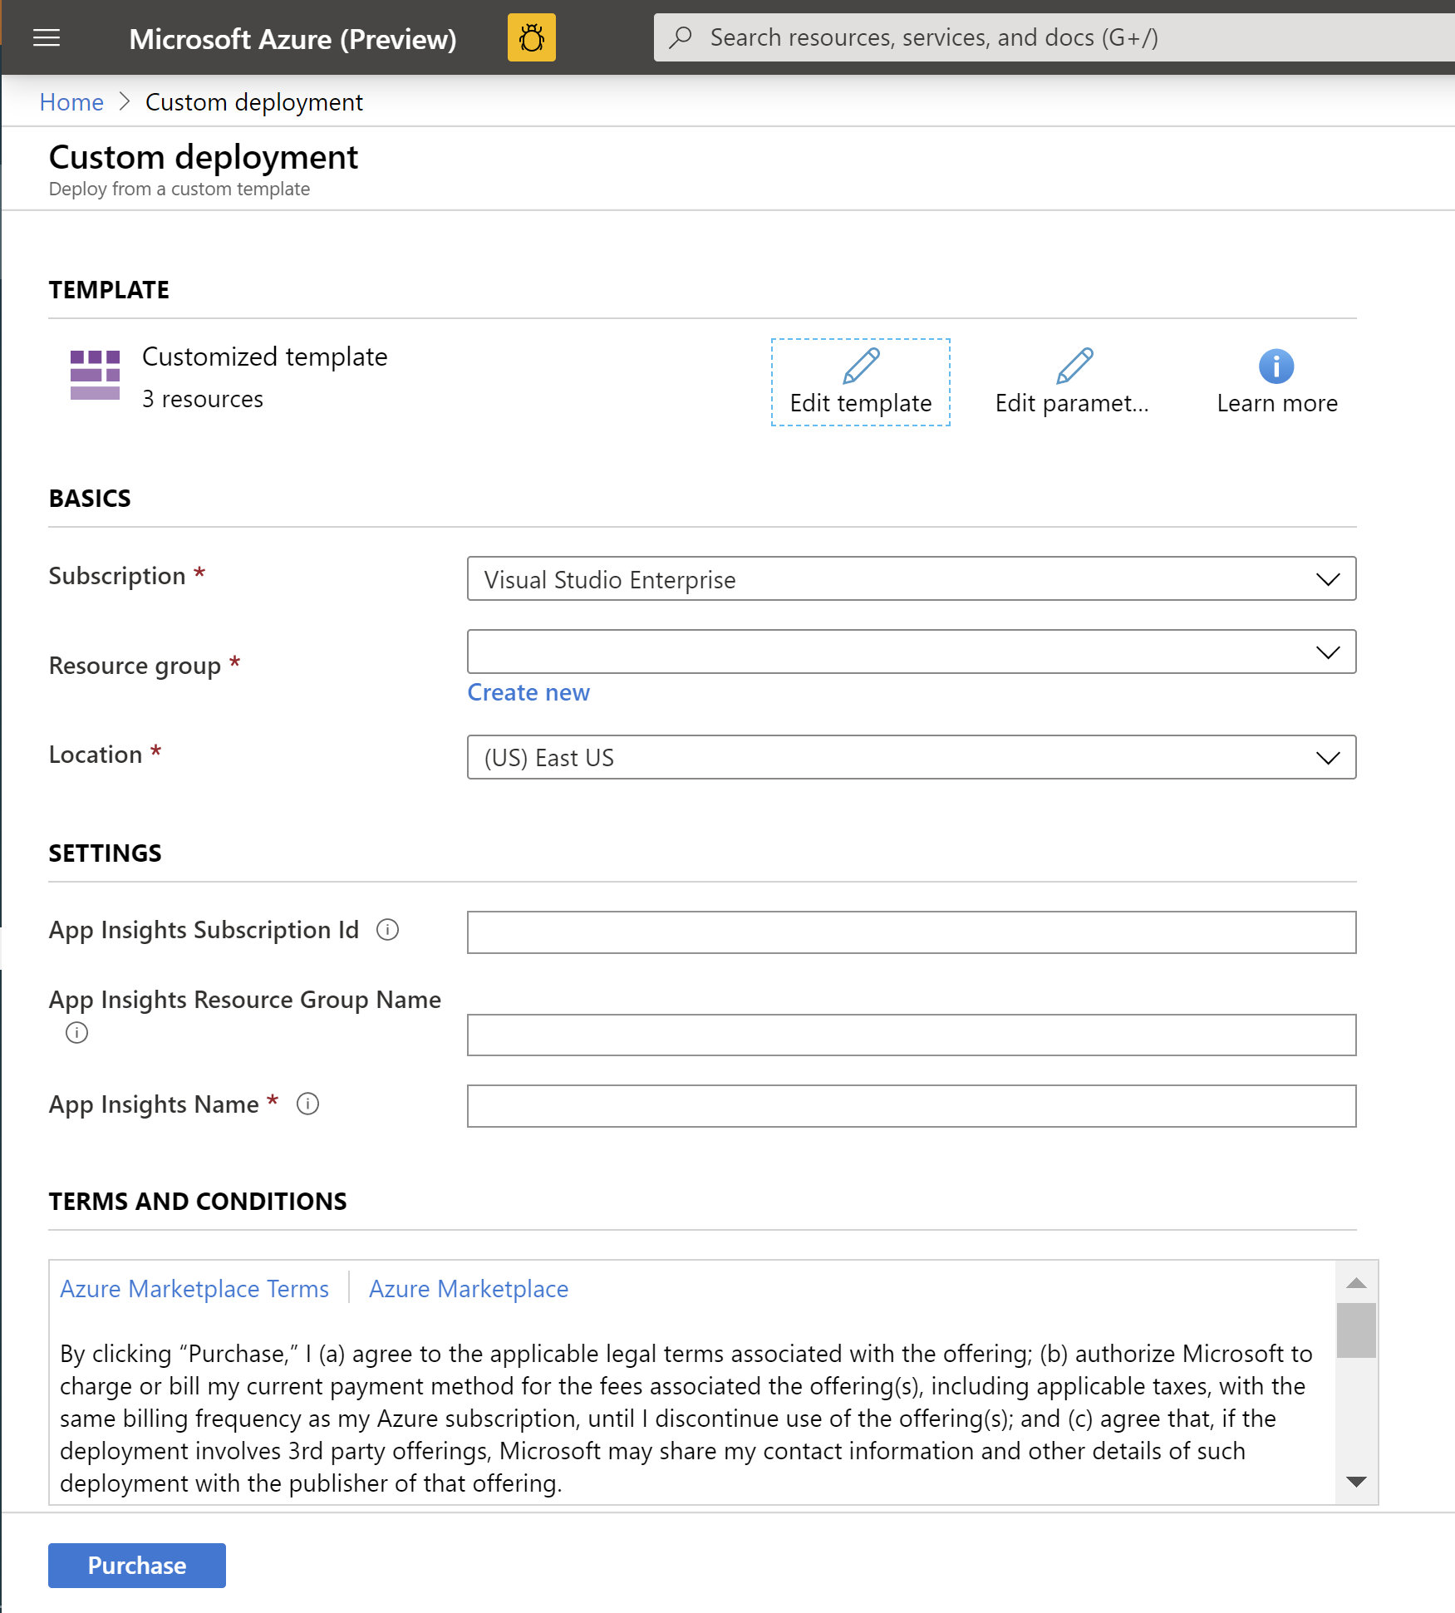
Fill in the deployment template and click “Purchase”

Slide 21
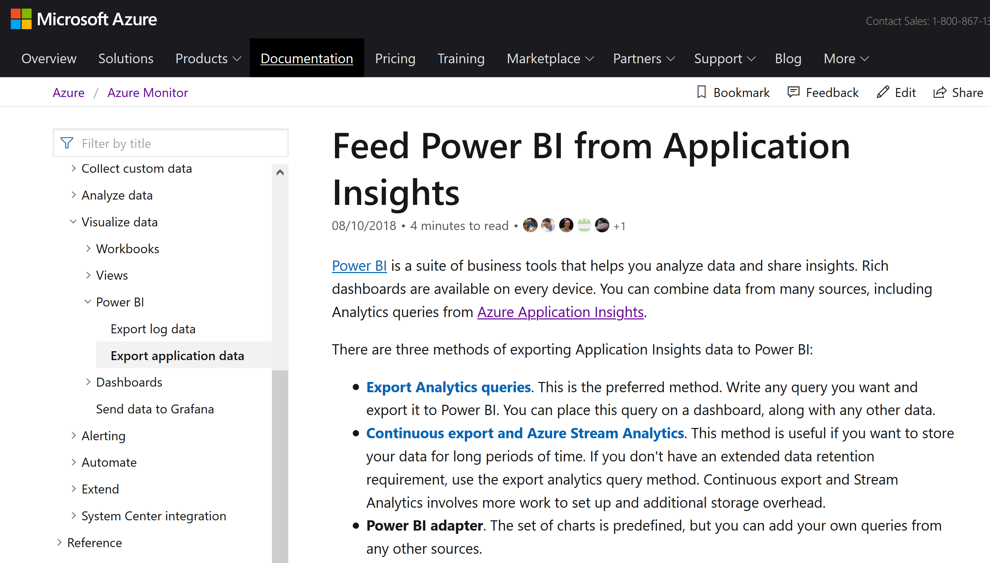
How to connect PowerBI to Application Insights
Notes:
https://docs.microsoft.com/en-us/azure/azure-monitor/app/export-power-bi

Slide 22
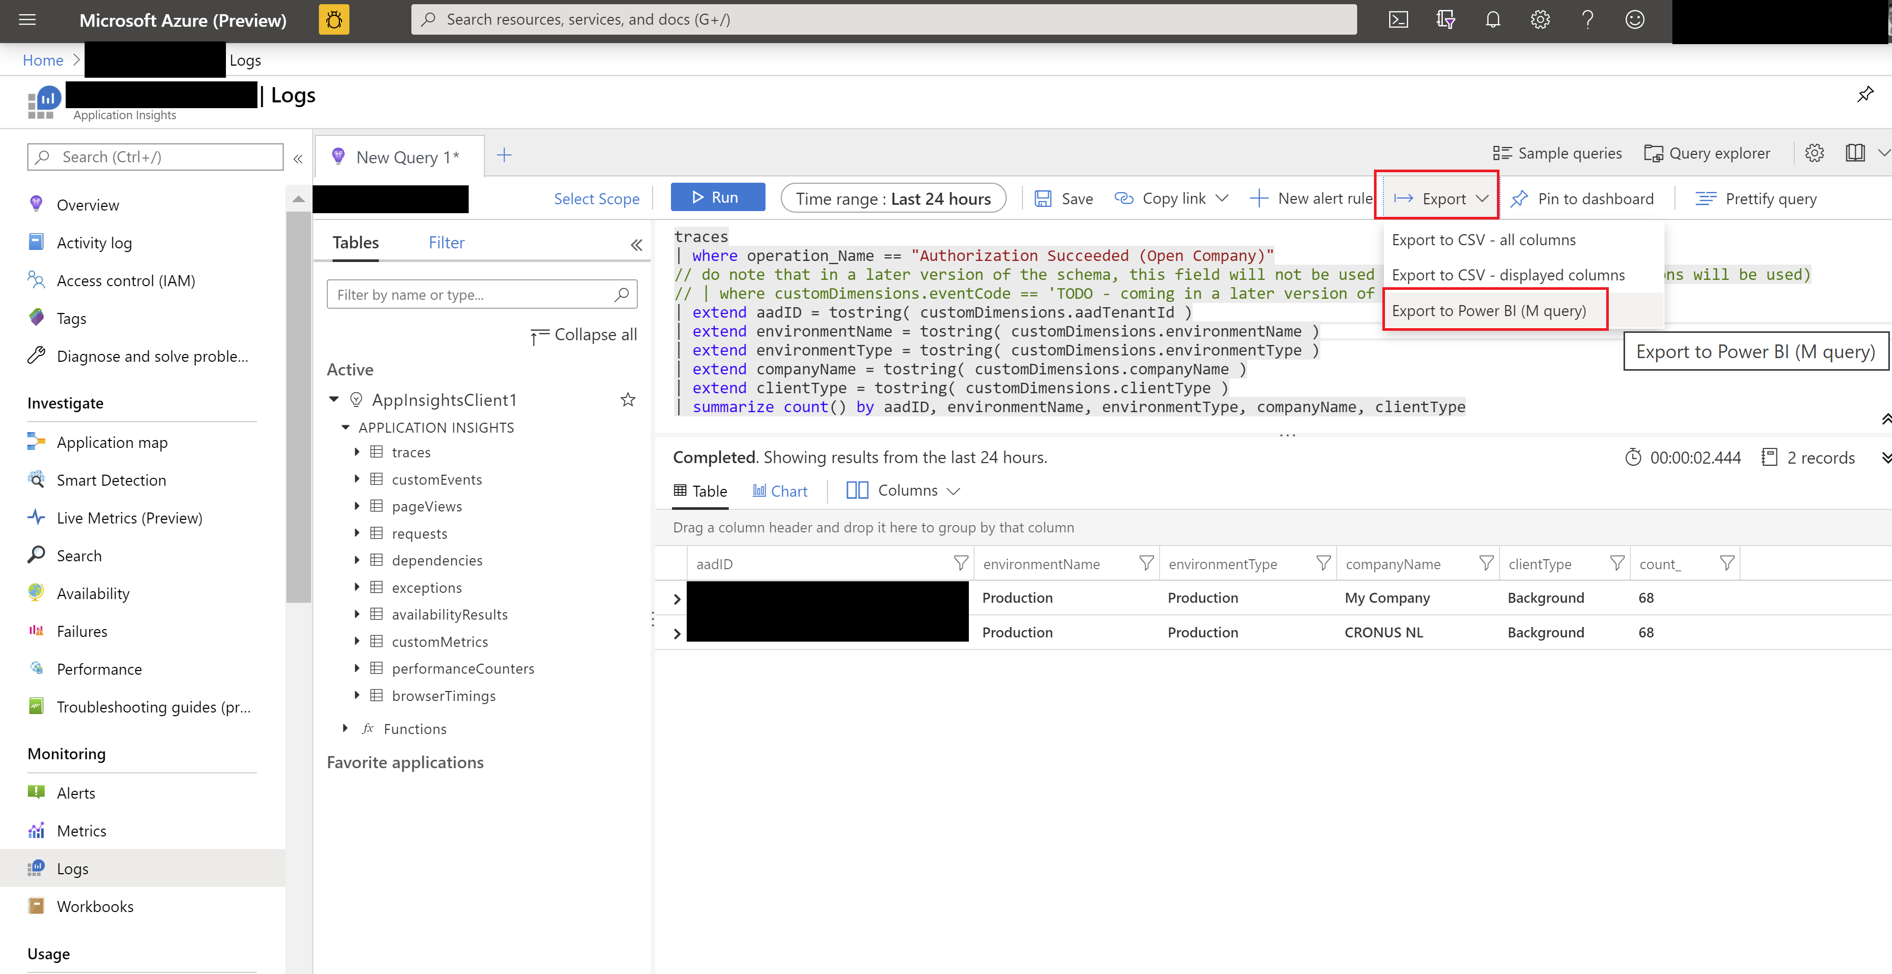
Export KQL query to M query (to be used in PowerBI)

Slide 23
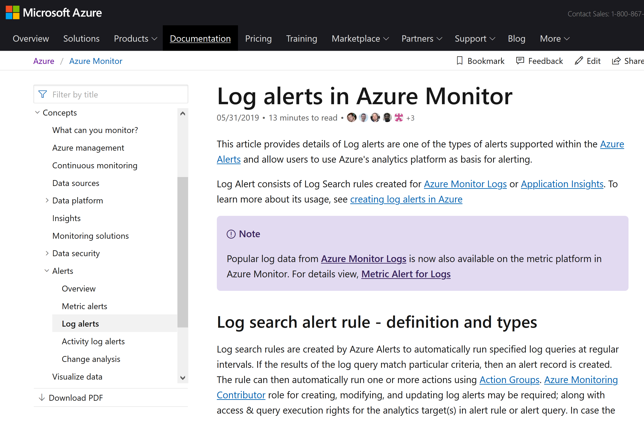
How to set up log alerts in Azure Monitor based on a Kusto query
Notes:
https://docs.microsoft.com/en-us/azure/azure-monitor/platform/alerts-unified-log

Slide 24
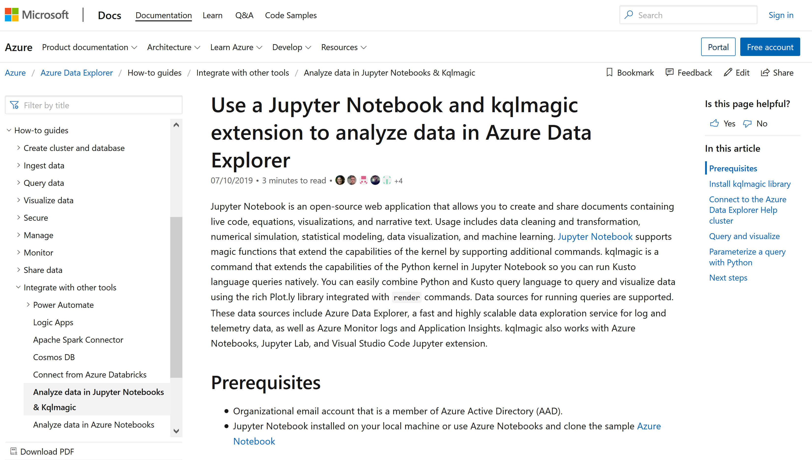
Notes:
https://docs.microsoft.com/en-us/azure/data-explorer/kqlmagic

Slide 25
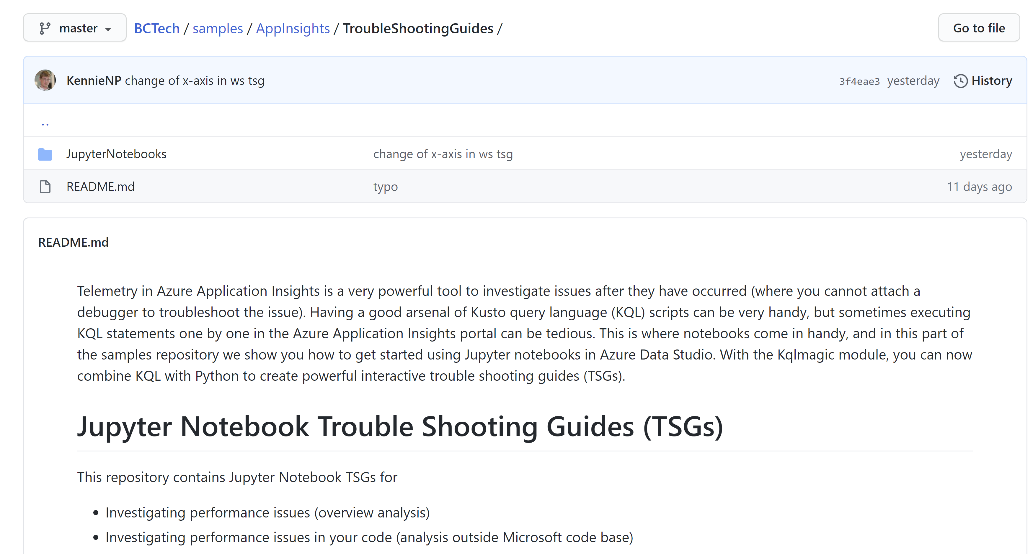

Slide 26
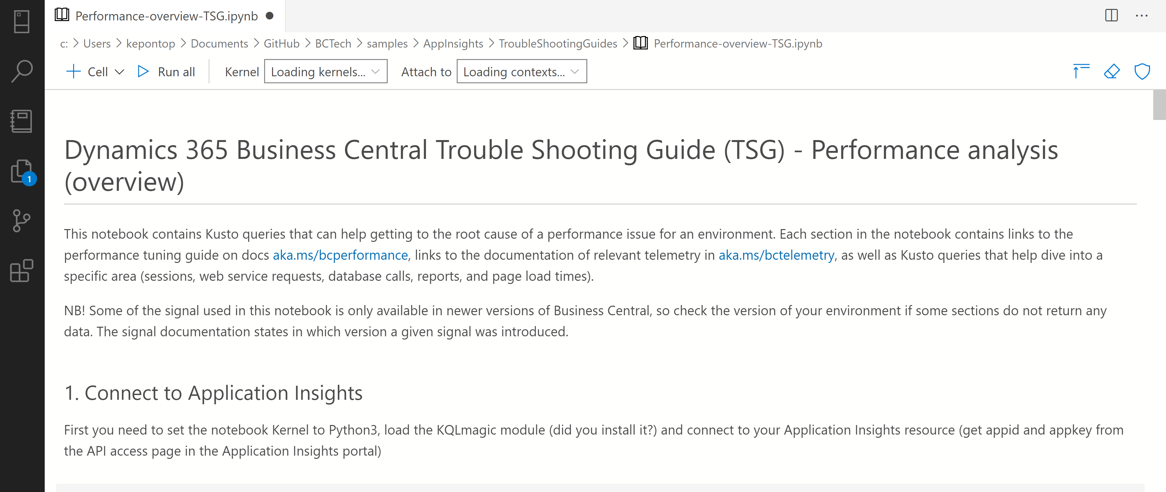
Jupyter notebooks for troubleshooting

Slide 27
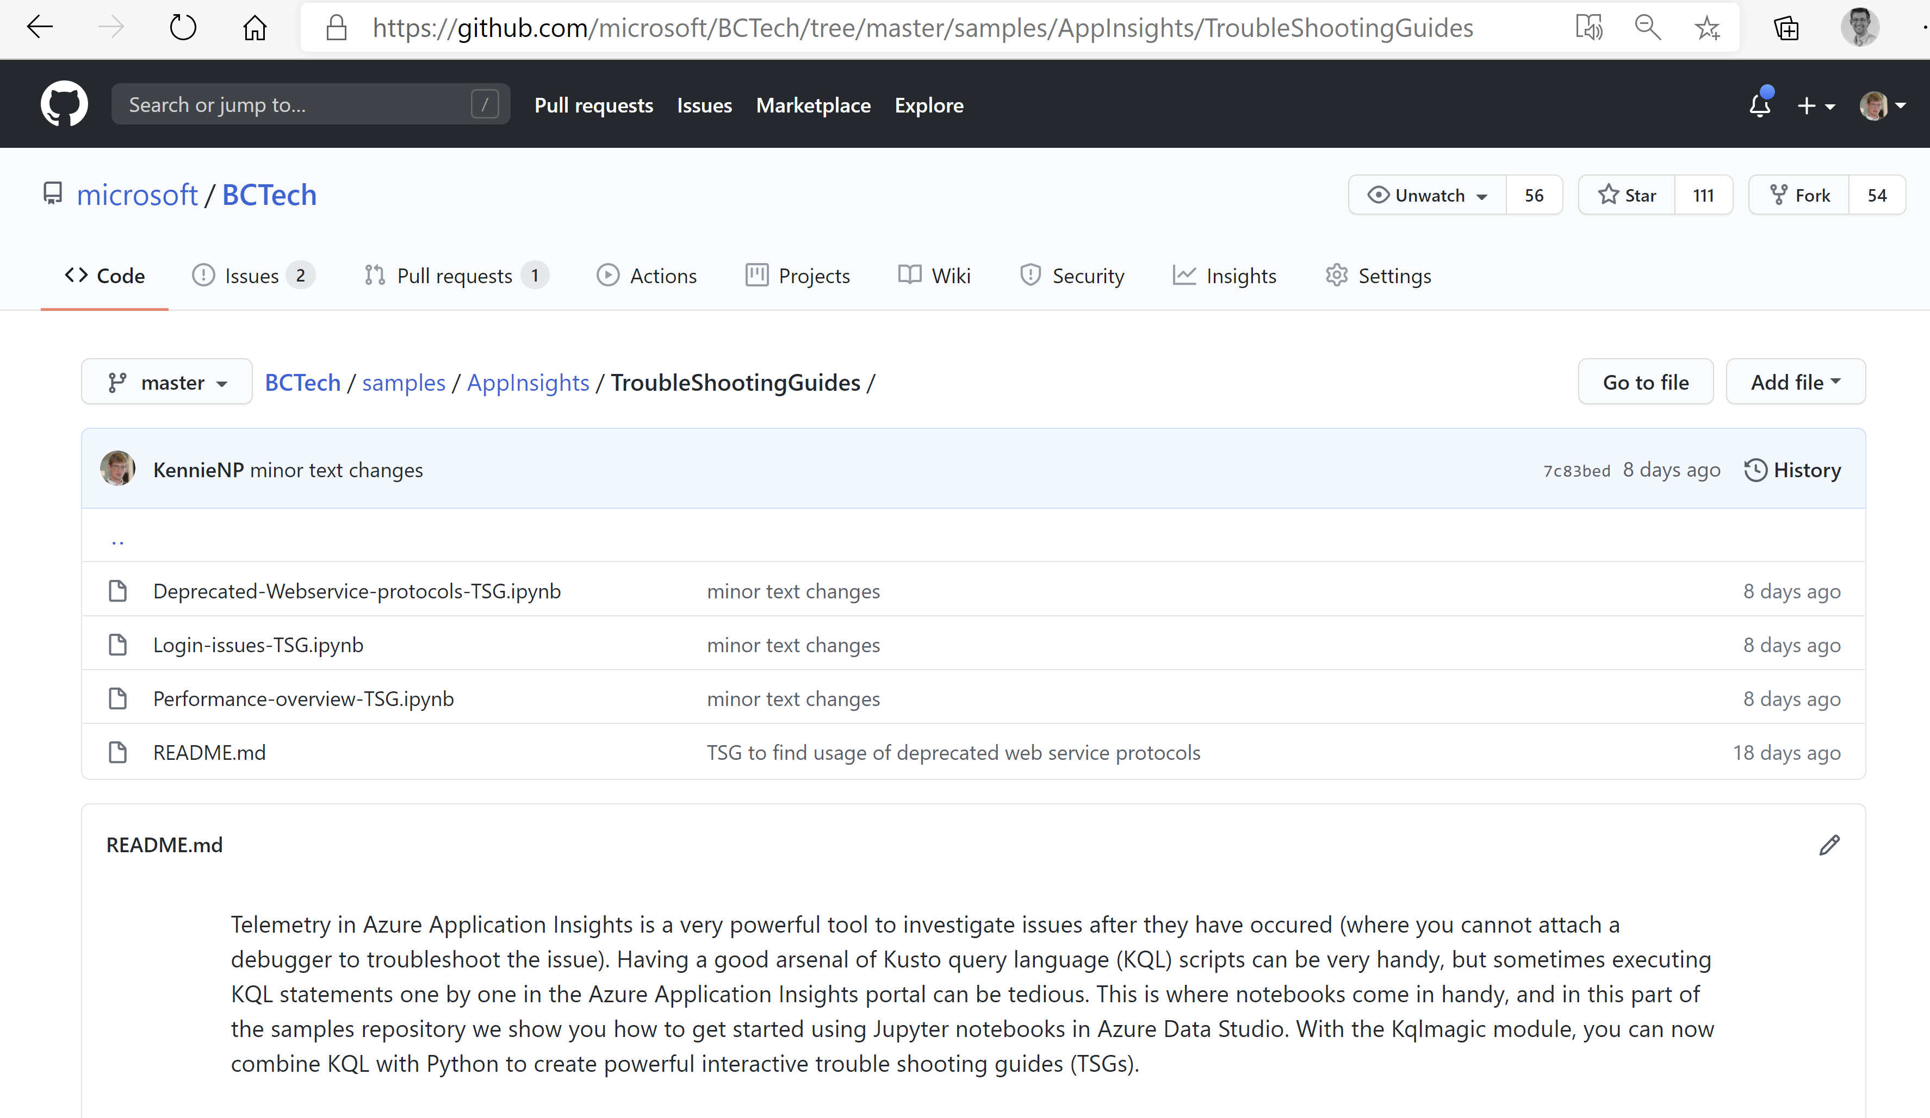
Get Jupyter notebooks here
https://github.com/microsoft/BCTech/tree/master/samples/AppInsights/TroubleShootingGuides

Slide 28
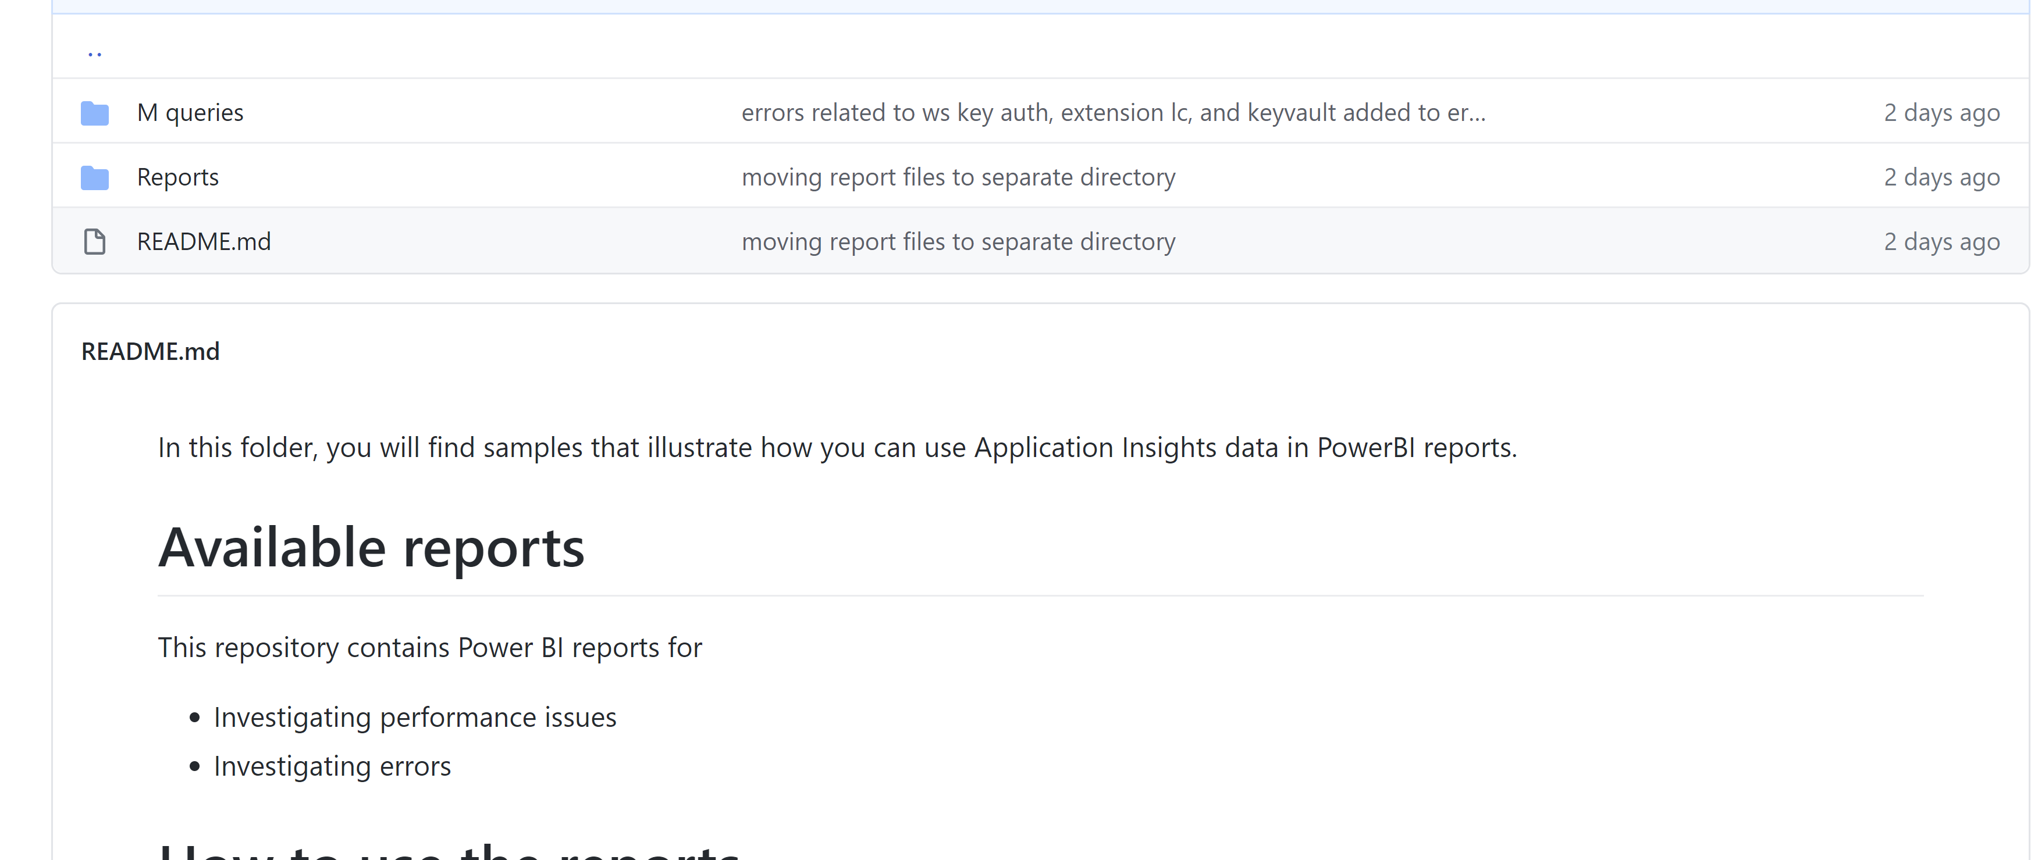
Out-of-the-box reports available

Slide 29
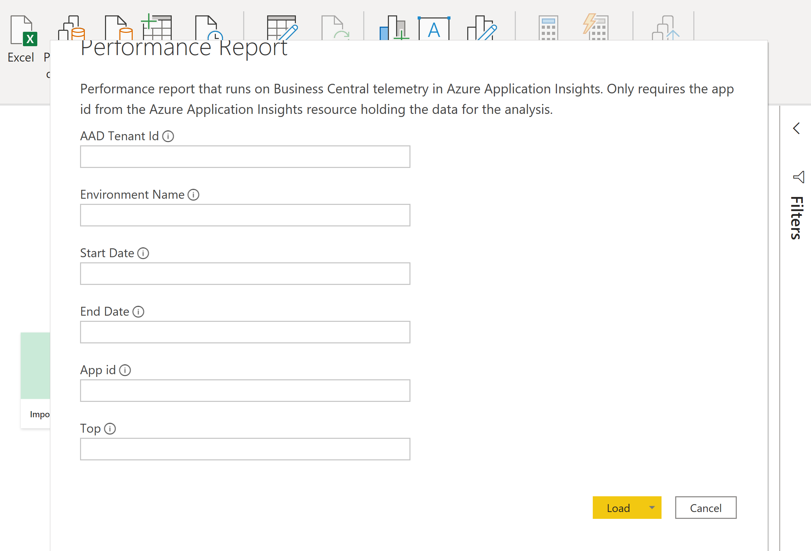

Slide 30
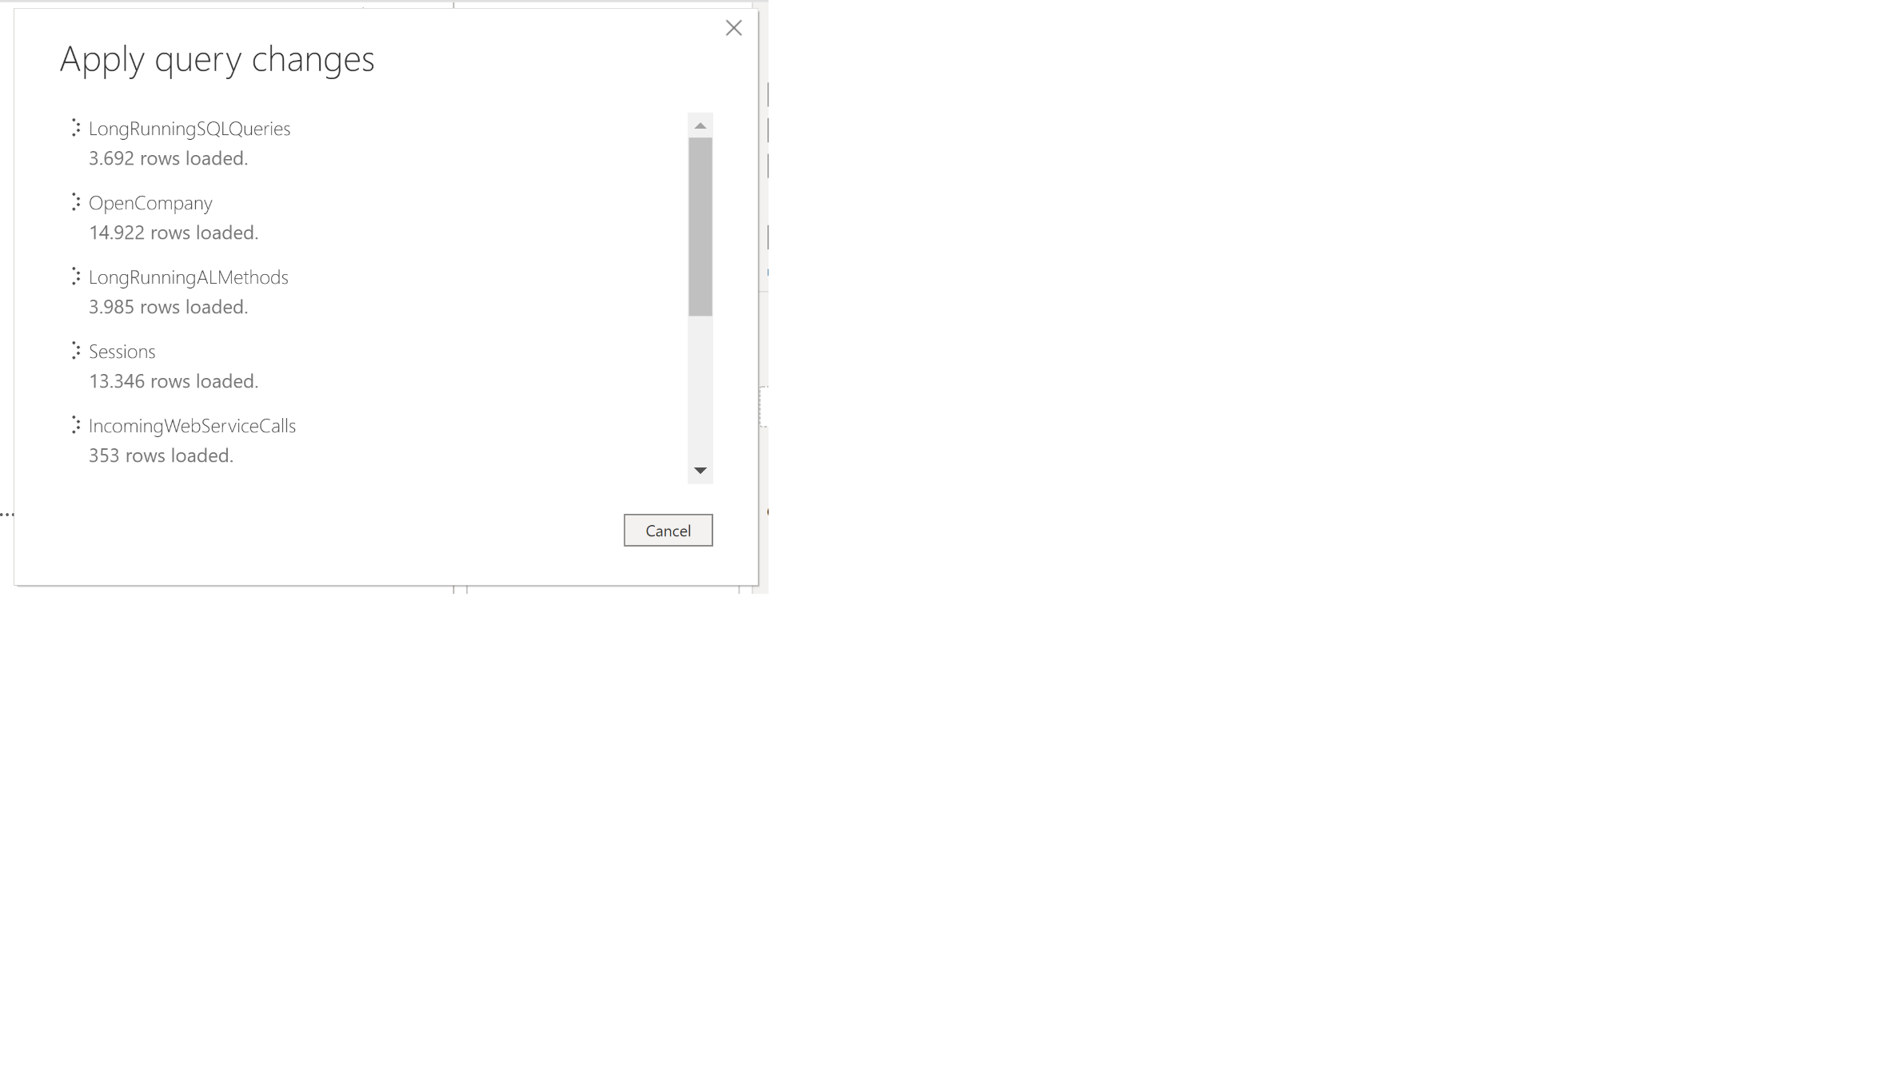

Slide 31
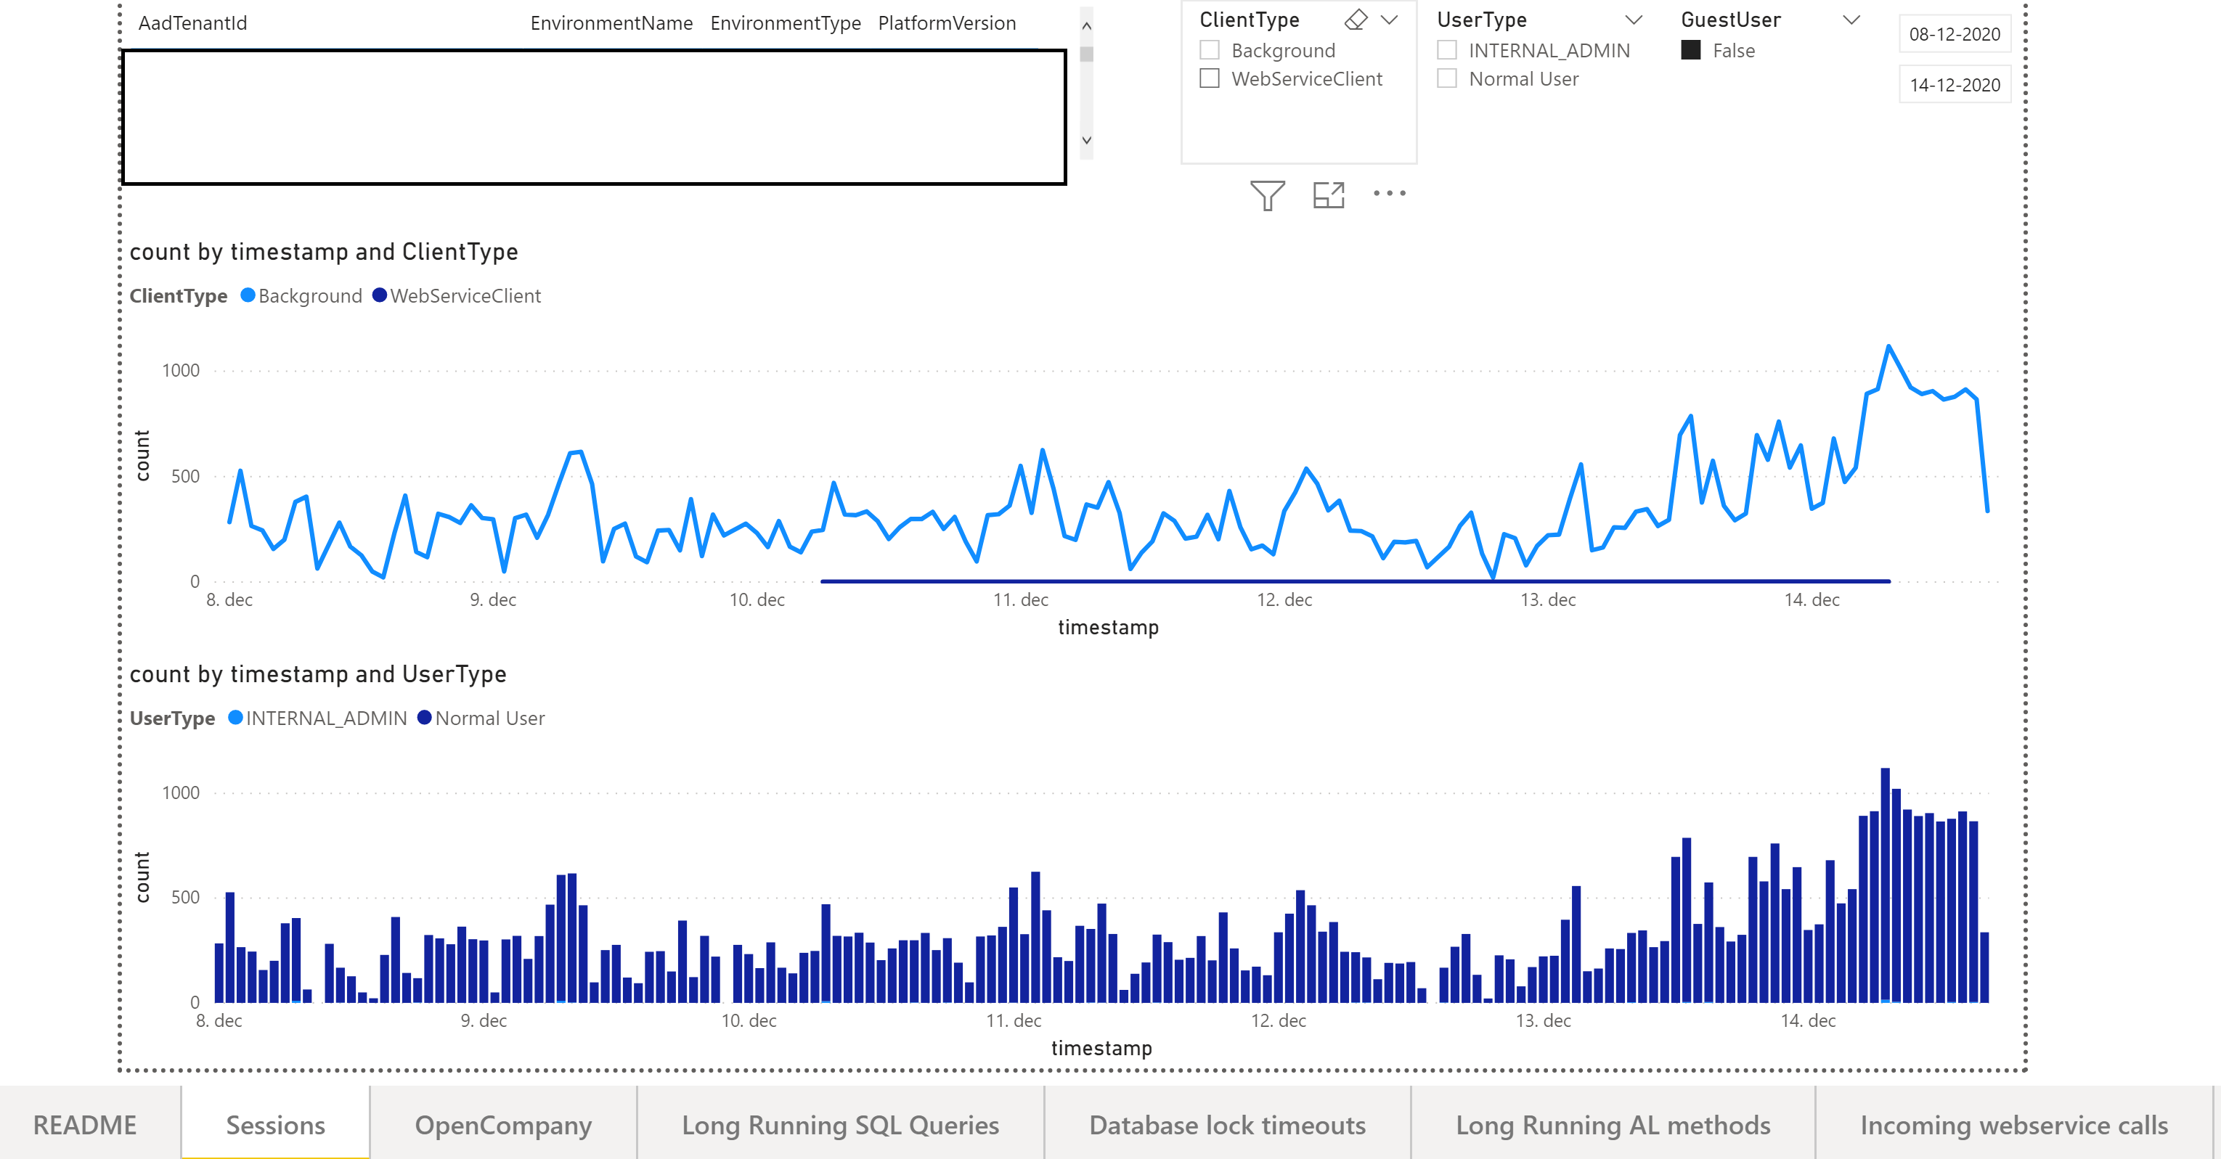

Slide 32
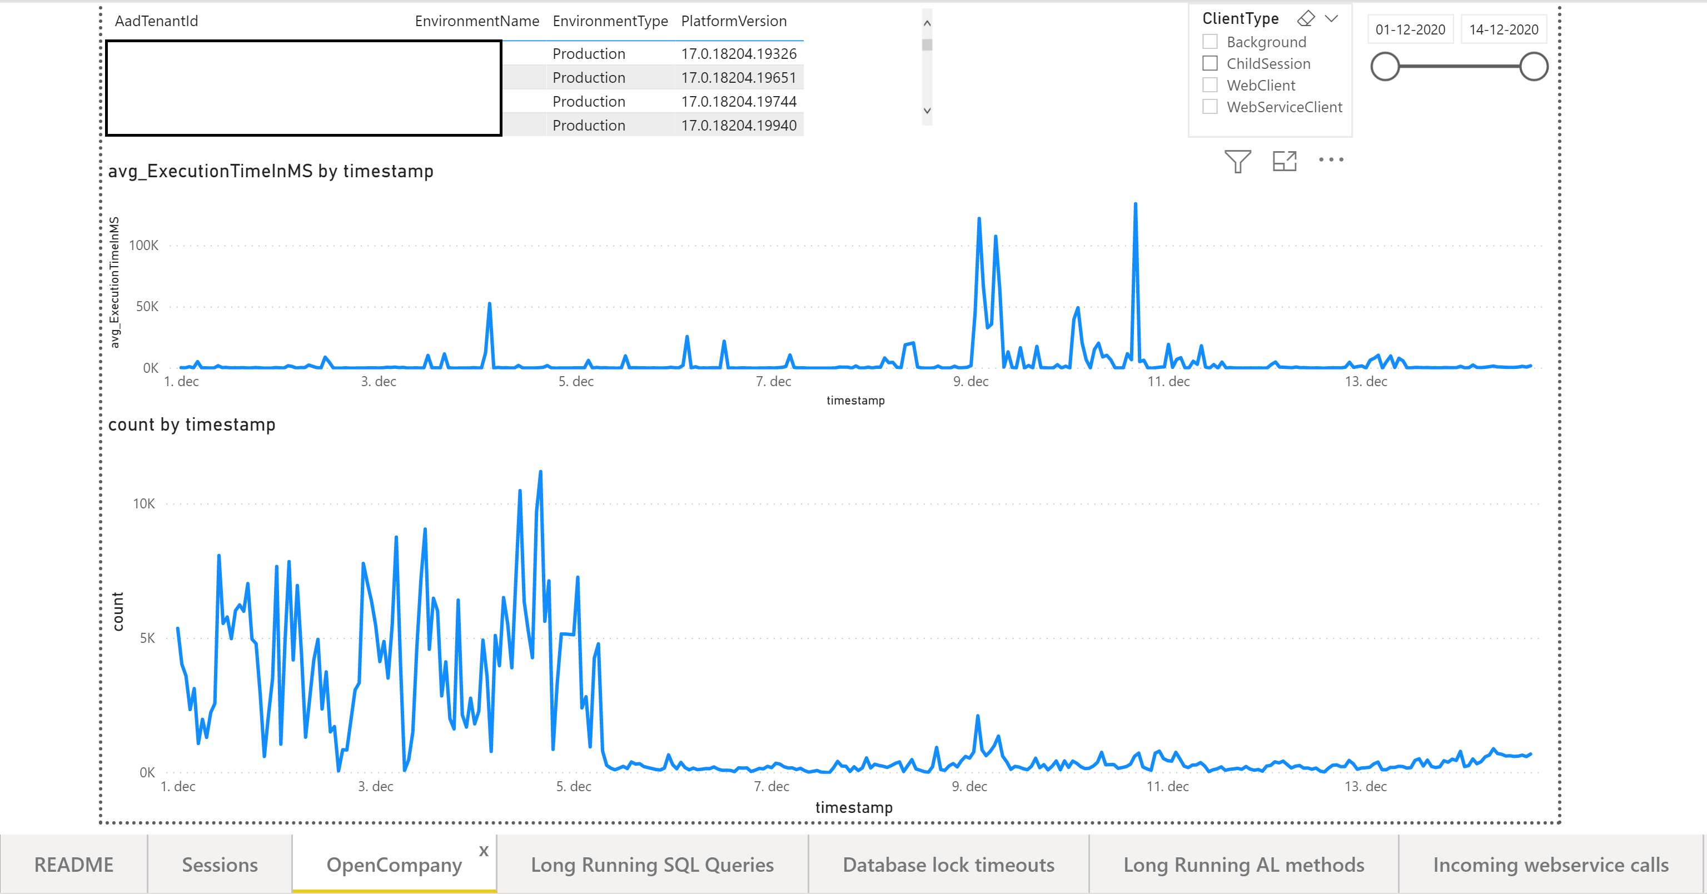

Slide 33
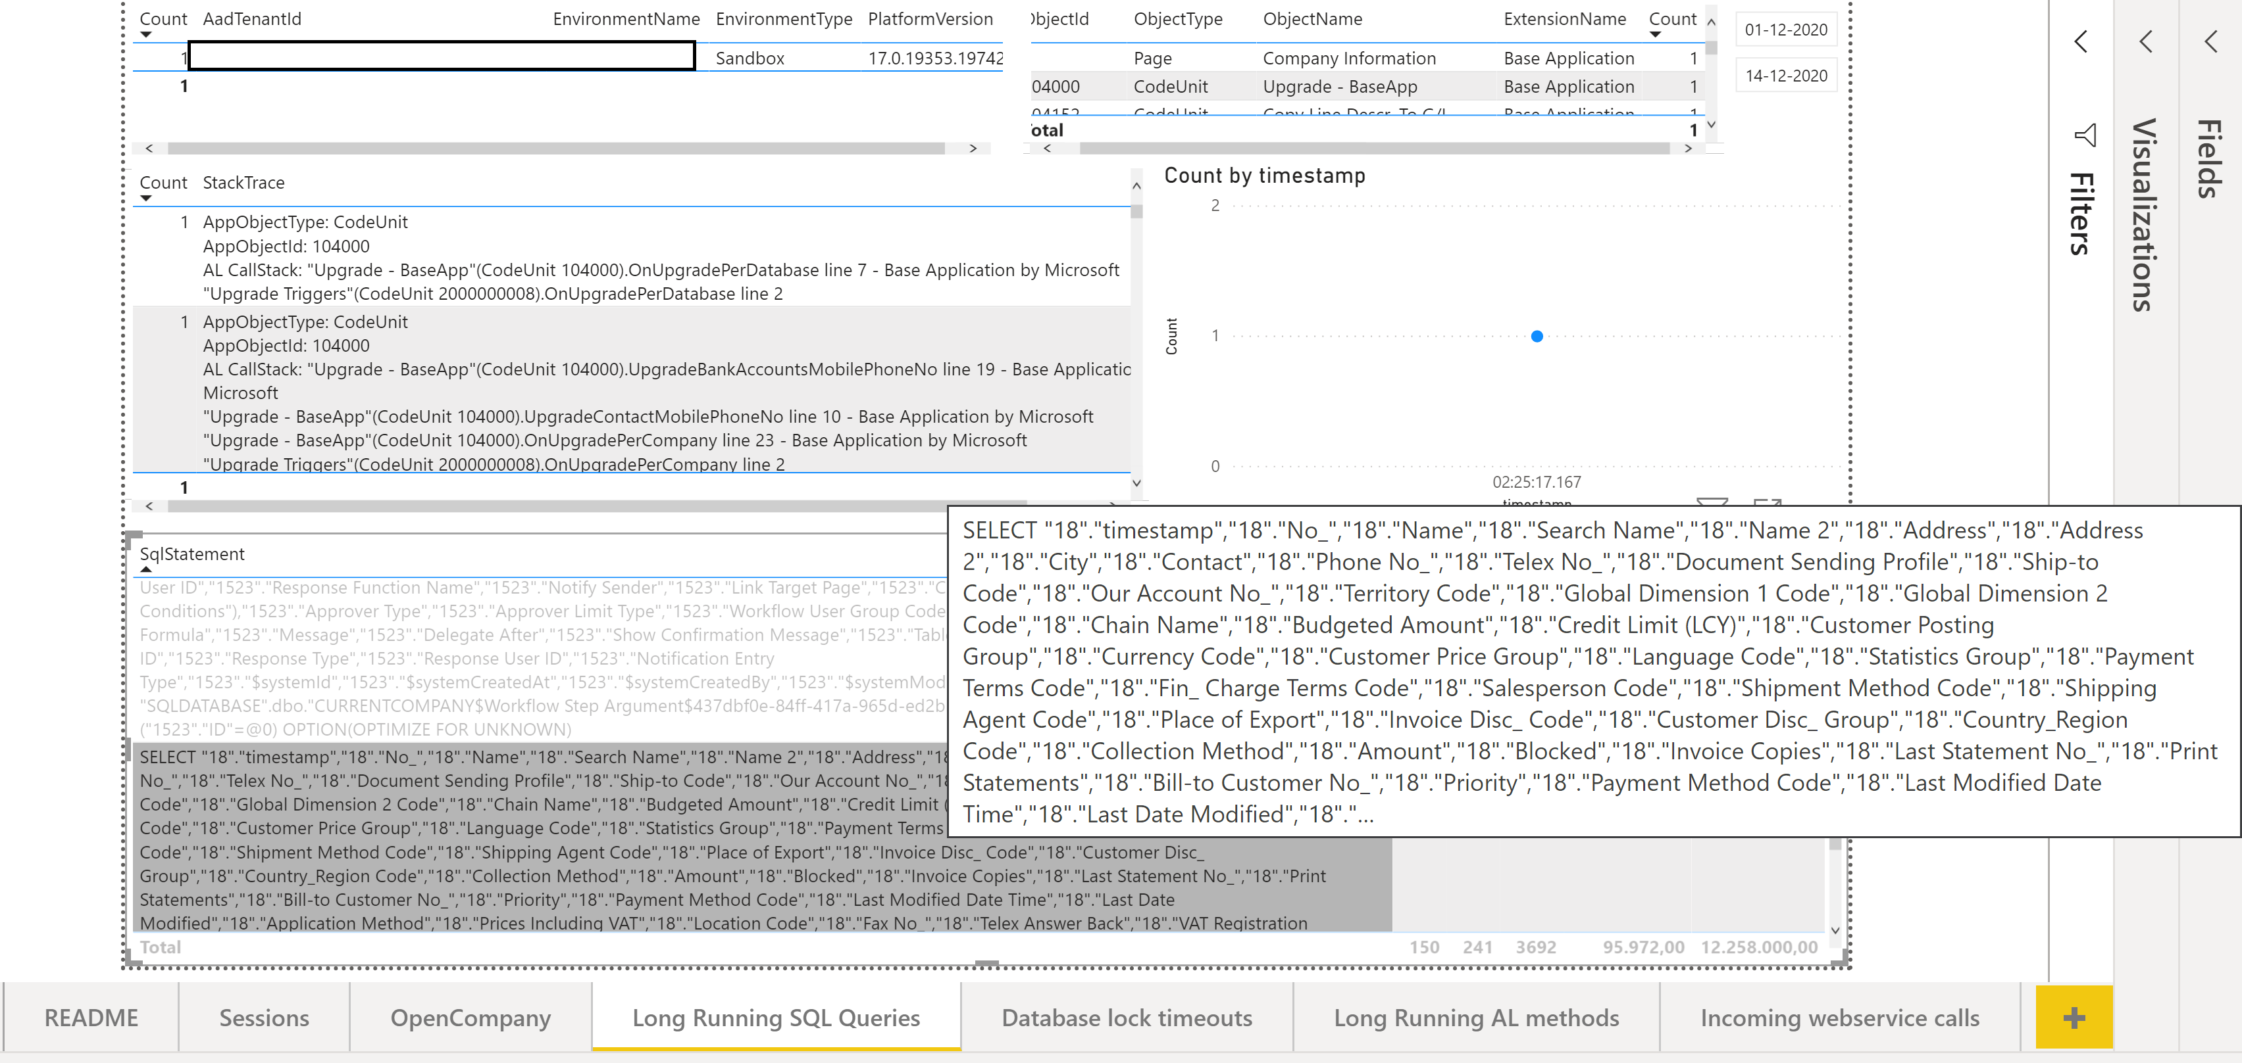

Slide 34
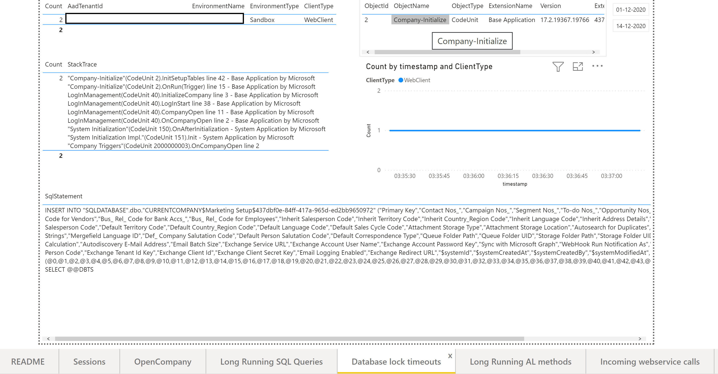

Slide 35
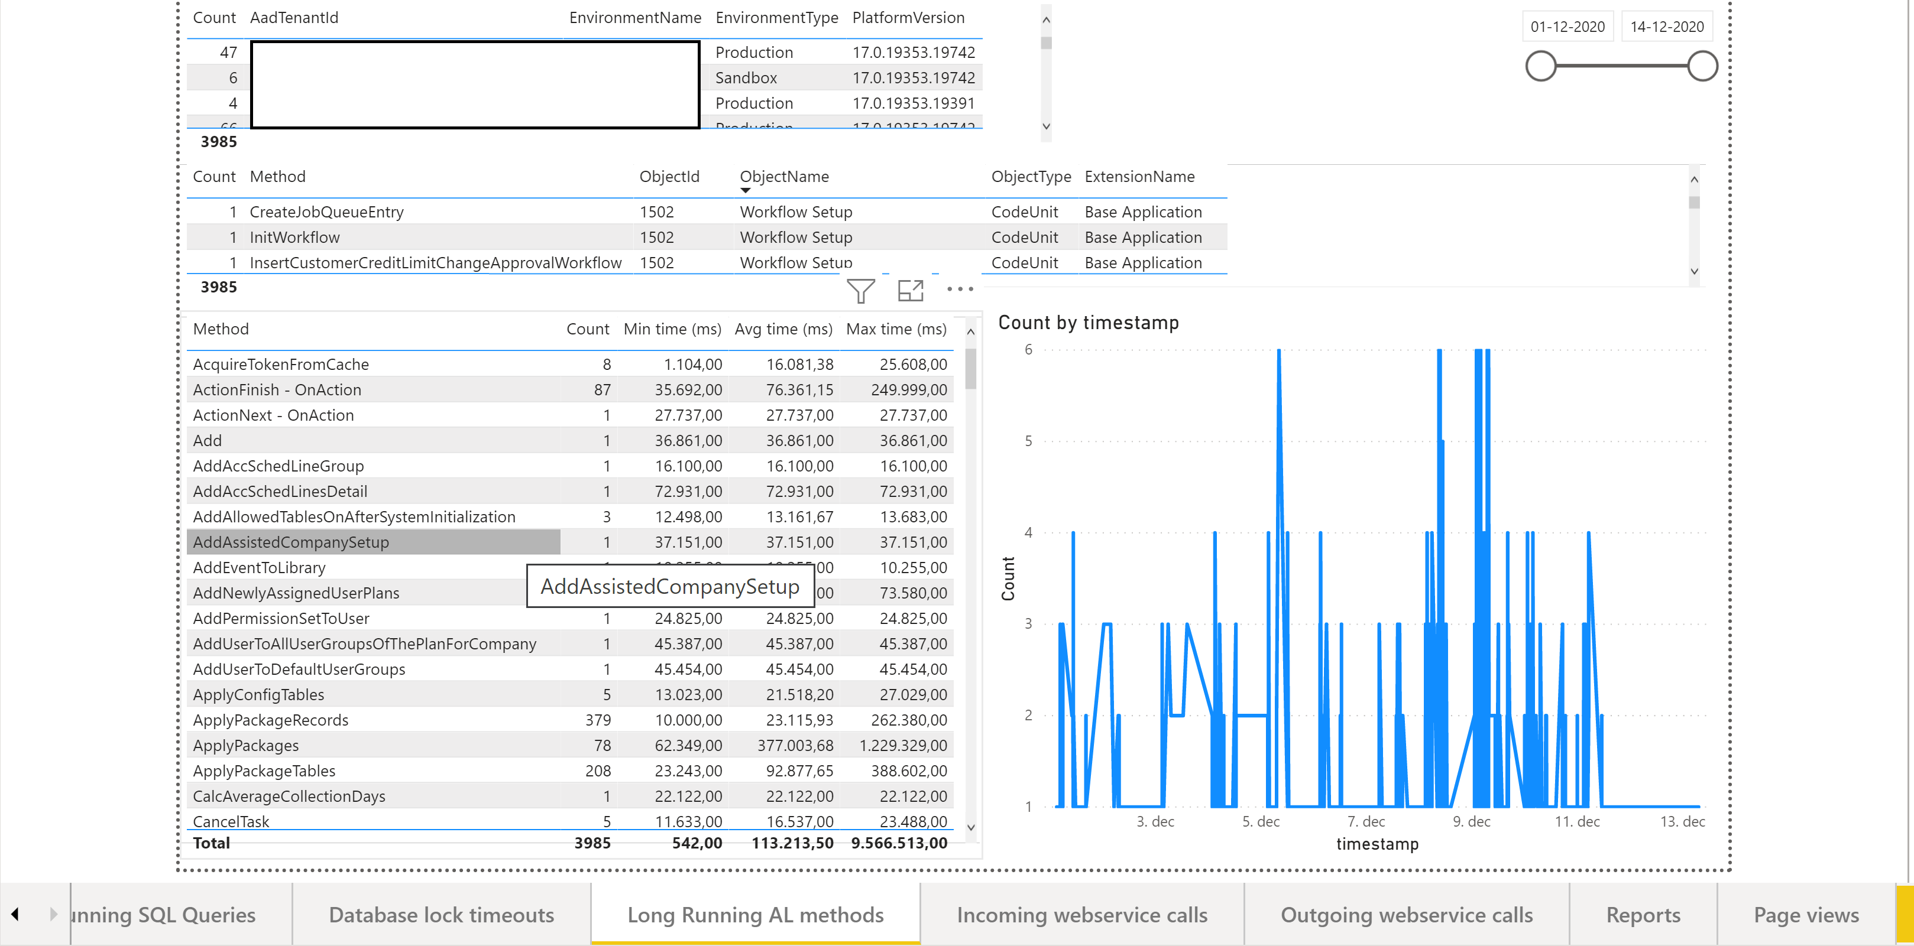

Slide 36
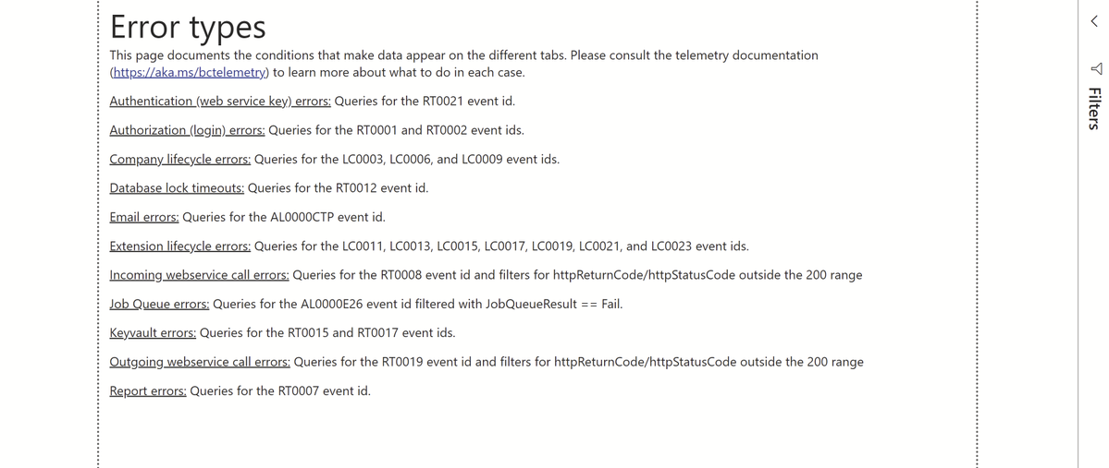
Error report

Slide 37
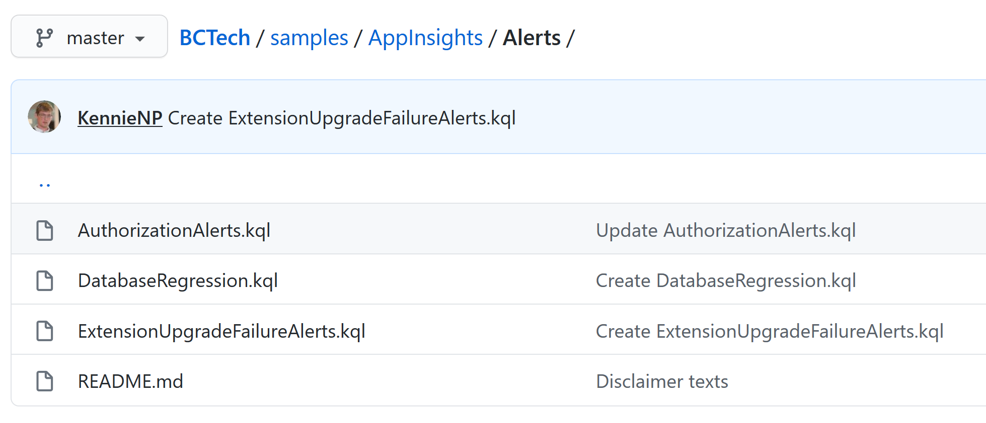
KQL sample code for alerts
Notes:
https://github.com/microsoft/BCTech/tree/master/samples/AppInsights/Alerts

Slide 38
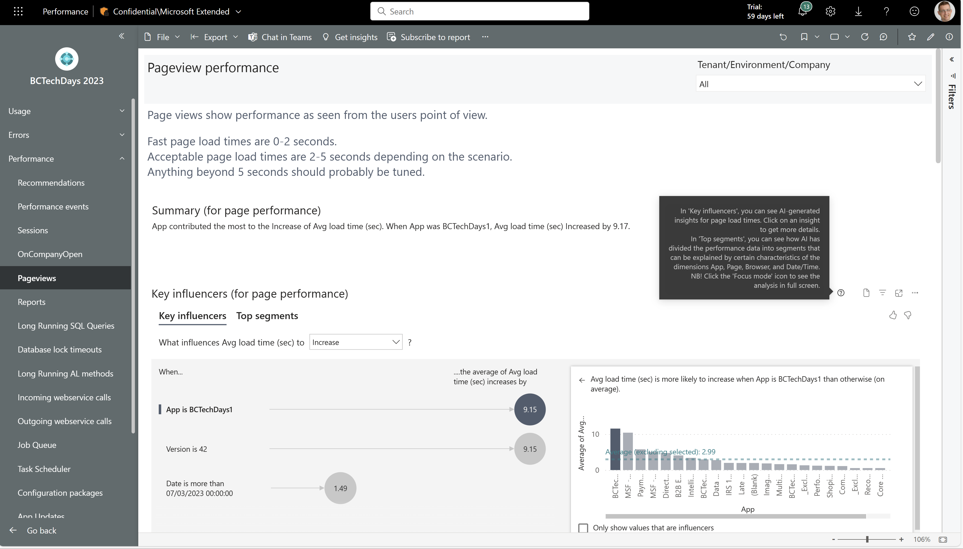
[Performance]: Partners get AI to assist on analyzing performance
Partners can get help from AI to assist in analyzing performance issues
All pages in the Performance report of the Power BI apps on telemetry now have AI-driven visuals (Smart narrative, Key influencers, and Decomposition Tree) as the top part of the report. Partners can use this as a starting point and then dive into details from that.
N/A
N/A
June 20 (aligned with BCTechDays 2023)

Slide 39
AI narrative that sums up the insights in natural language
AI-generated insights that explain load time averages

Slide 40
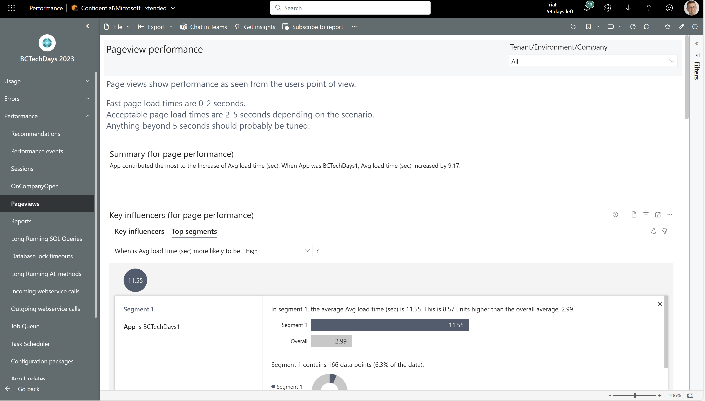
AI-generated segmenting of the data space

Slide 41
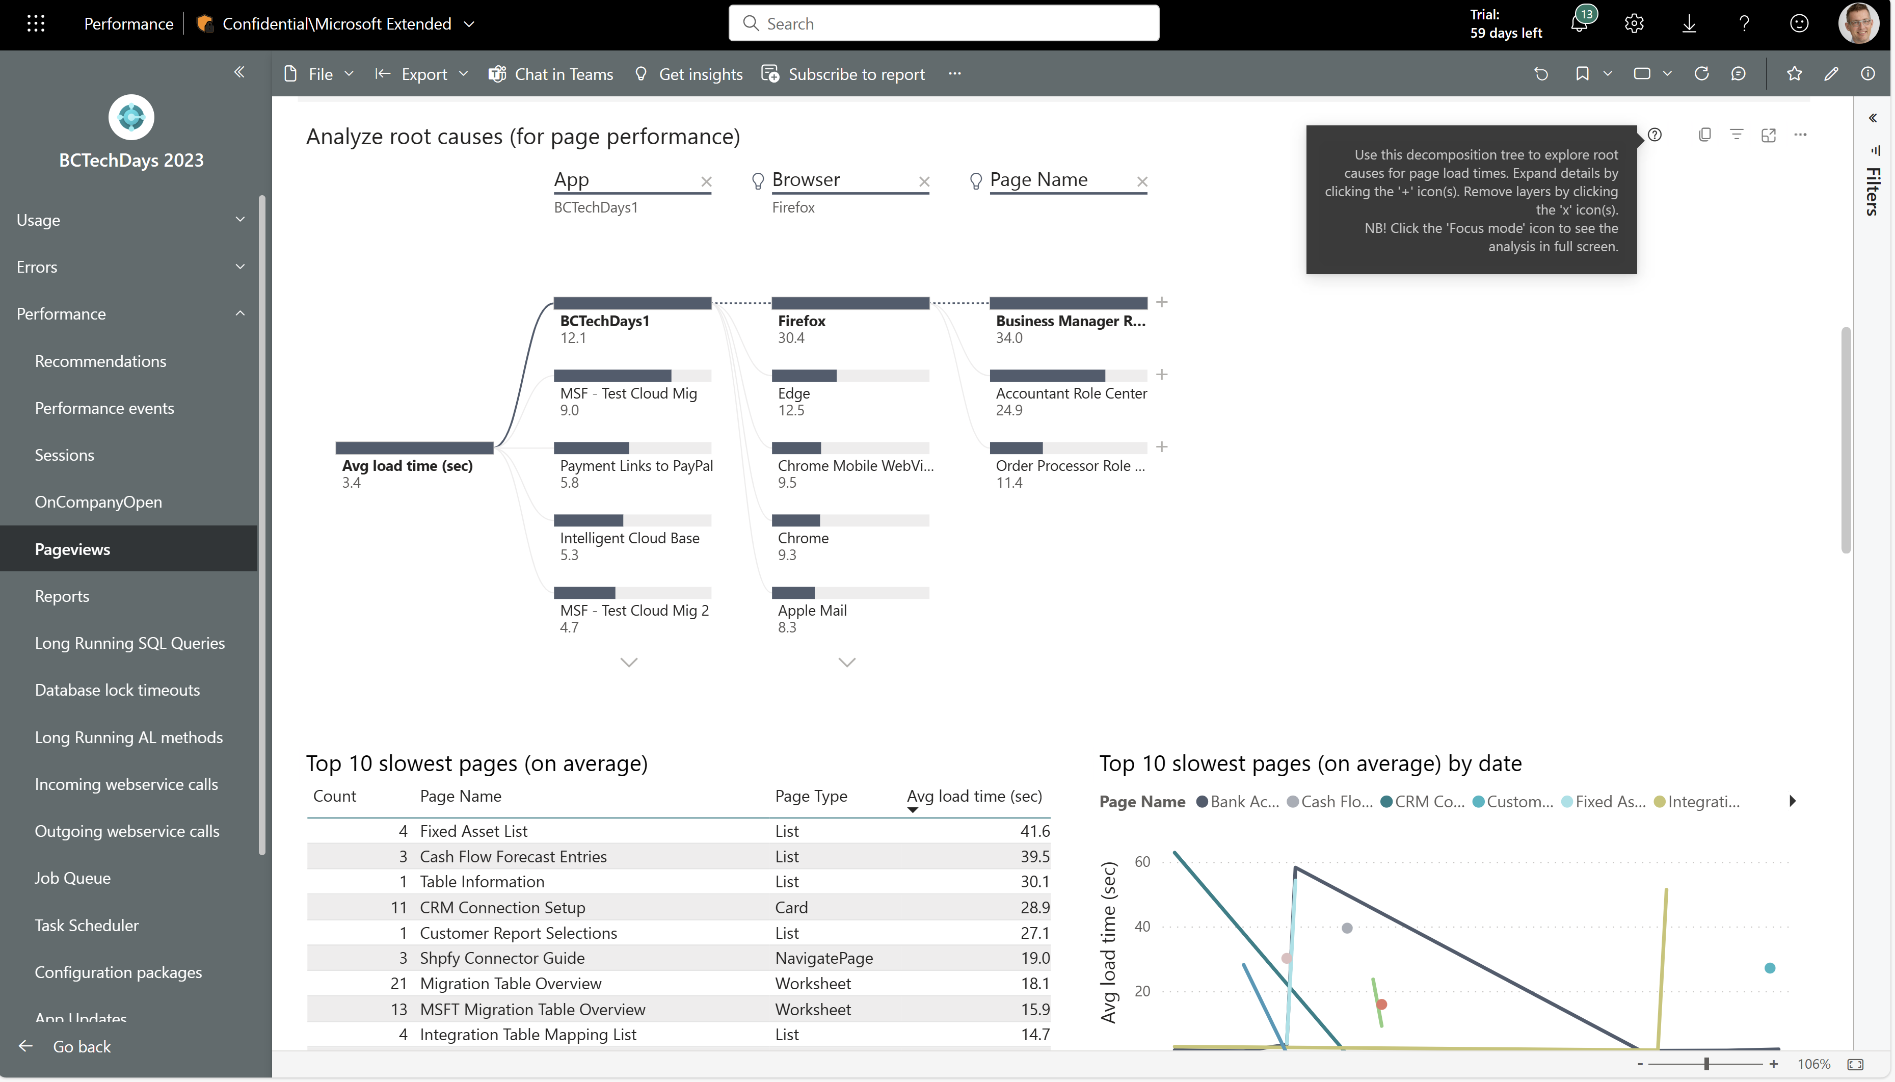
AI-generated tree that suggests dimensions that influence load time averages. User can interact with this

Slide 42
Traditional top-N analysis

Slide 43
Try it yourself
This Power BI app is what Steffen will demo on at the BCTEchDays 2023 keynote:
https://msit.powerbi.com/groups/me/apps/f101a162-032d-4028-bf53-799b3d070408/reports/d26d53de-a7e8-4af9-8dc8-f89ece18308a/ReportSection50a33a51c65b31ce6bf8?ctid=72f988bf-86f1-41af-91ab-2d7cd011db47&experience=power-bi
Give it a spin yourself (Go to Performance -> Pageviews)

Slide 44
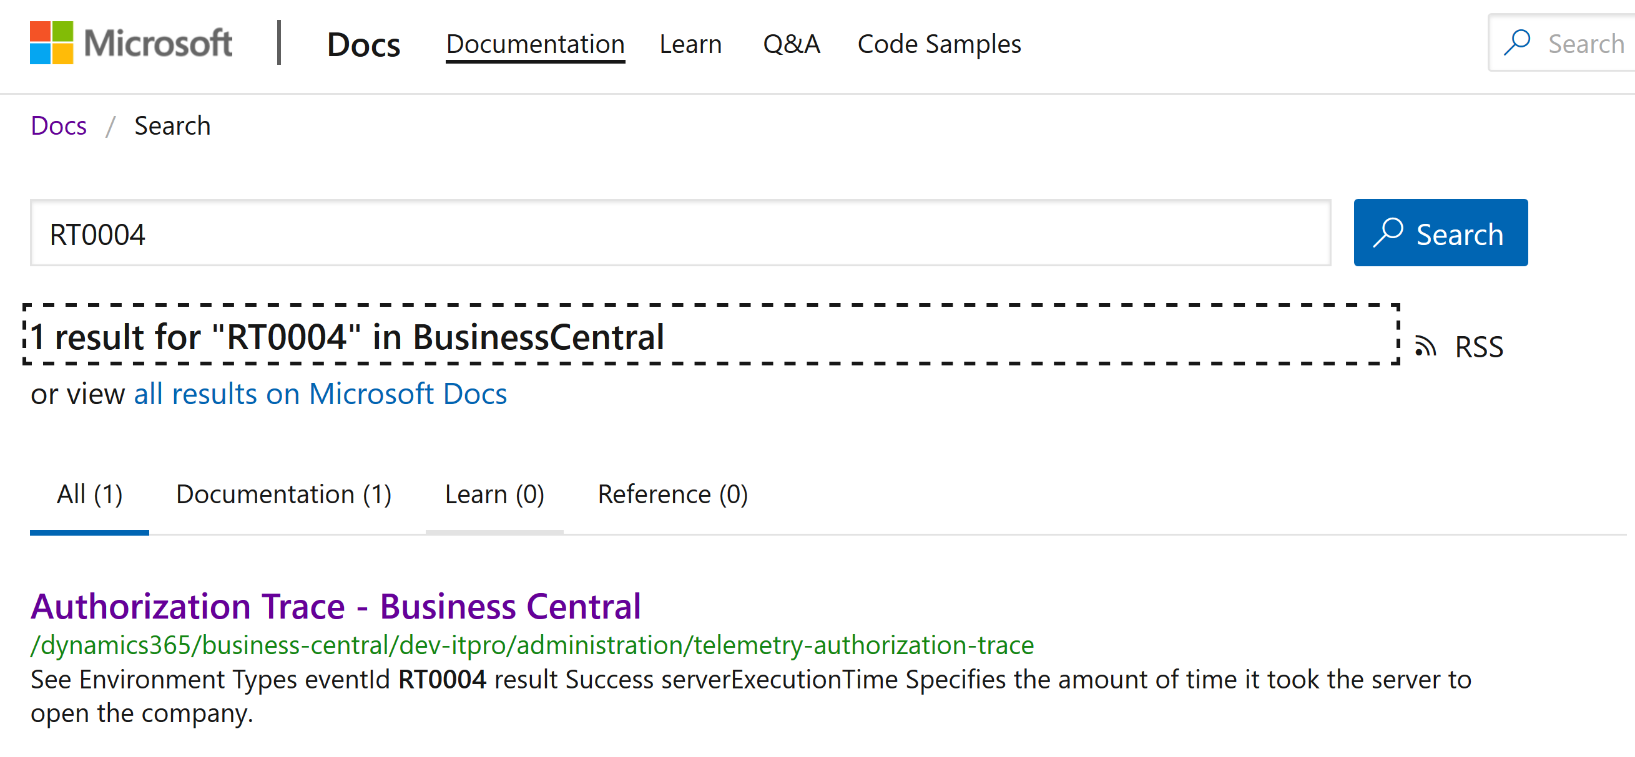
Search for documentation using the eventId
Notes:
We added a new custom dimension: eventId to #msdyn365bc partner telemetry in version 16.1

Slide 45
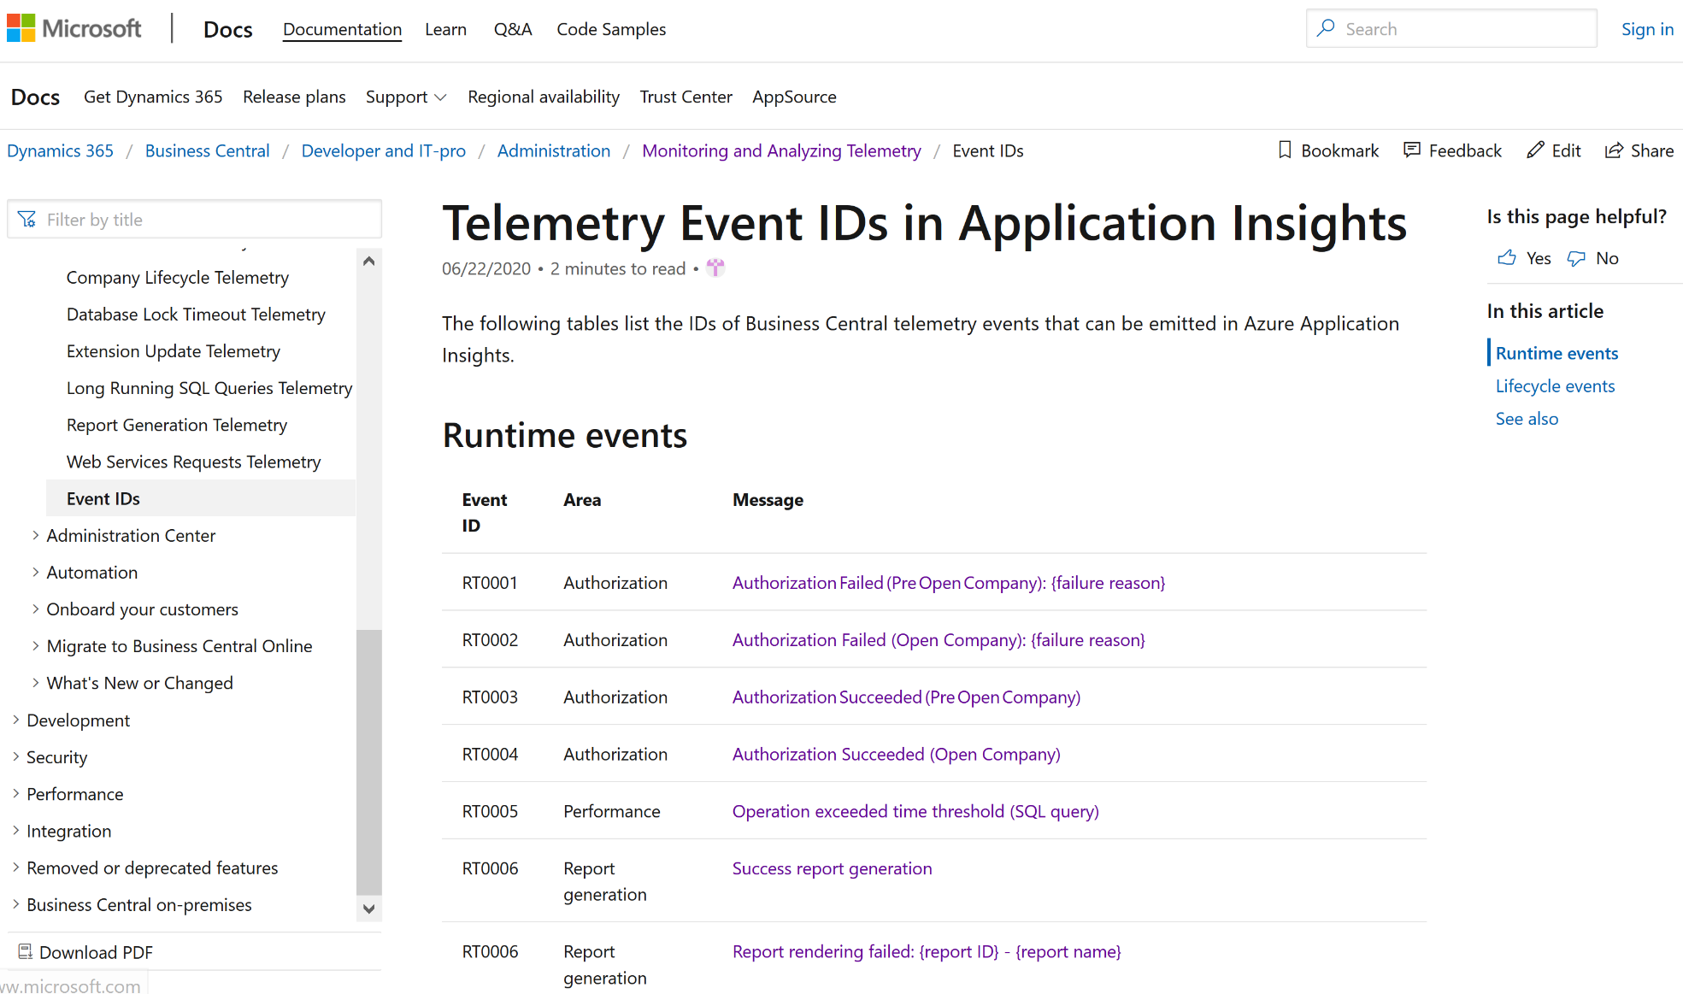
Notes:
https://docs.microsoft.com/en-us/dynamics365/business-central/dev-itpro/administration/telemetry-event-ids

Slide 46
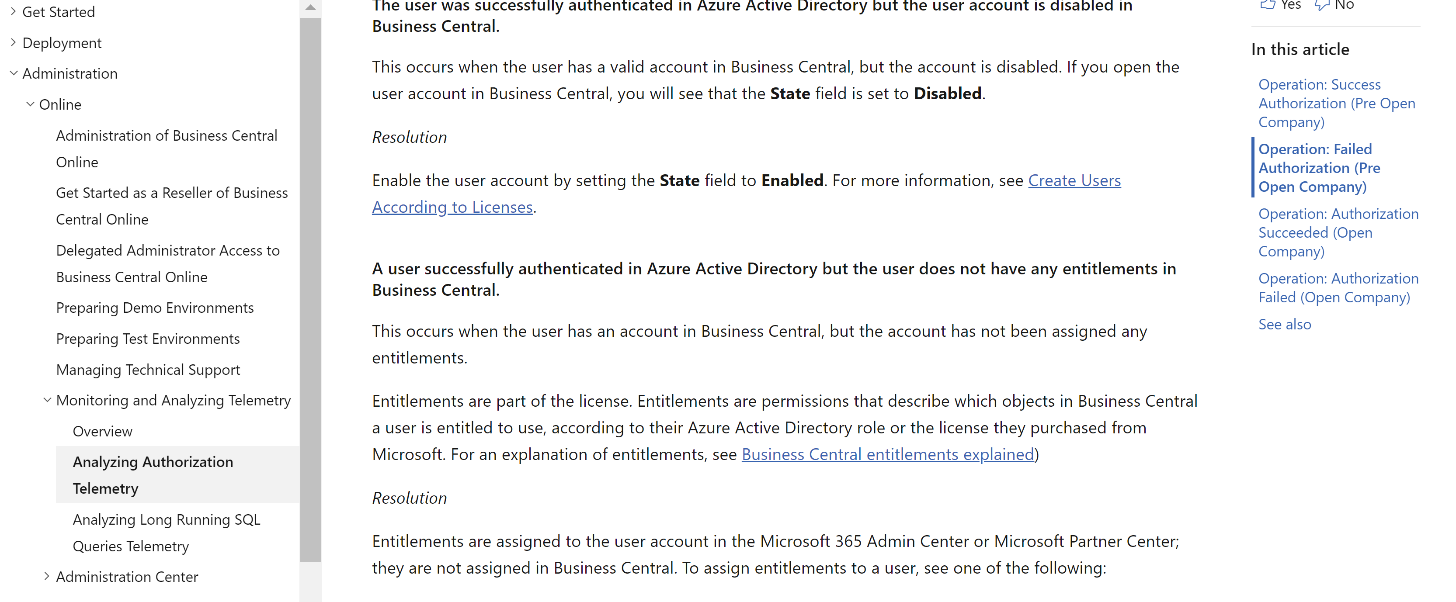
Example: Trouble Shooting Guide (TSG) on login failures (in docs)
Notes:
Authorization signal added in 15.3
https://docs.microsoft.com/en-us/dynamics365/business-central/dev-itpro/administration/telemetry-authorization-trace

Slide 47
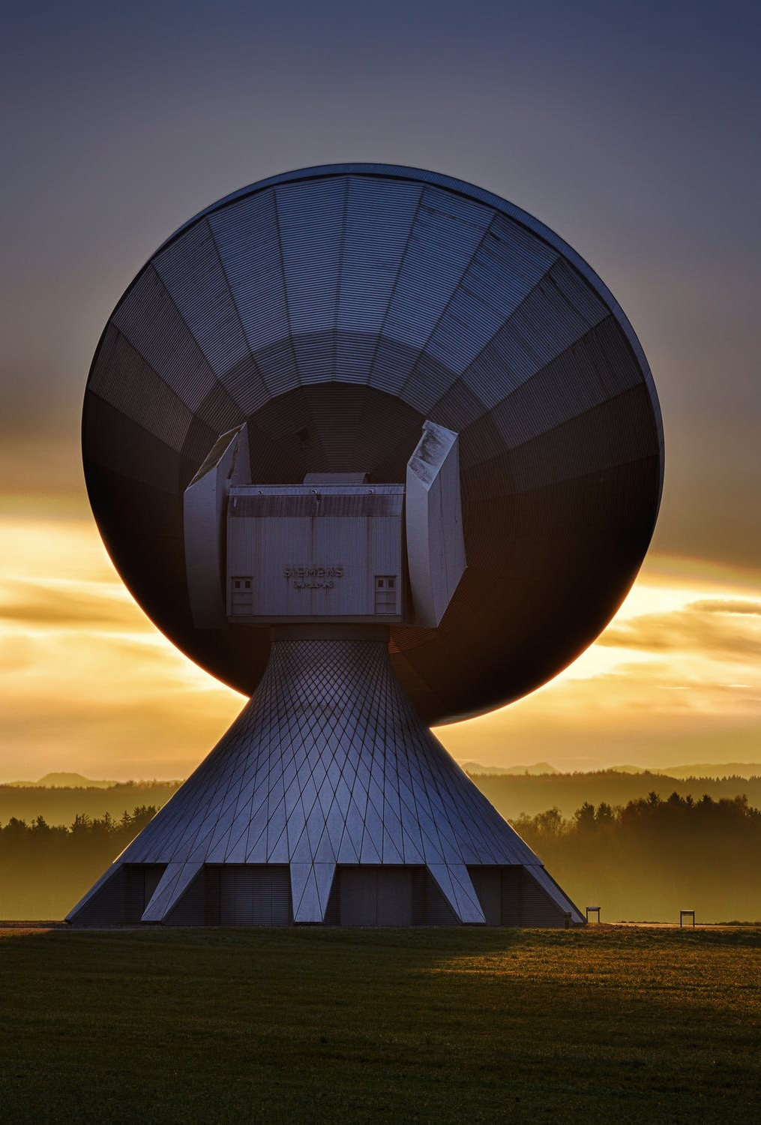
Example: What can you infer from web service signal?
Many messages where http headers contain “powerbi” => excessive powerBI reports
If signal + long running sql signal => maybe need to adjust/tune codeunit
If many 429 (Too Many Requests) => adjust client consuming web service end point
If many 408 (Timeout) => Tune code unit/page
If many requests <> API type => uptake API pages to get better perf
Notes:
Web service signal added in 16.0
Picture: https://www.pexels.com/photo/antenna-contact-dawn-dusk-33153/

Slide 48
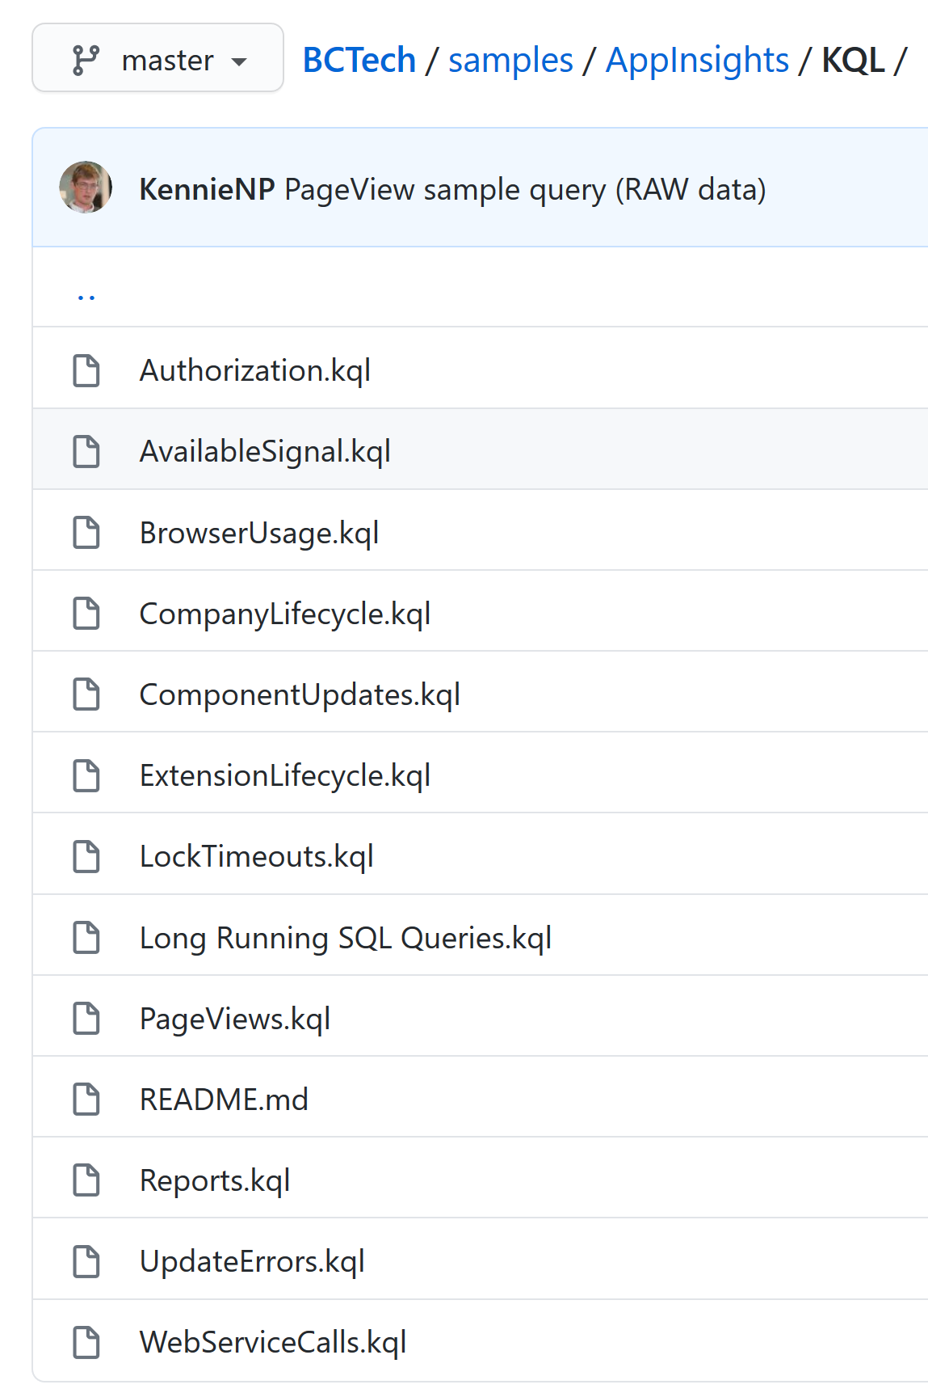
KQL sample code to get started quickly
Notes:
https://github.com/microsoft/BCTech/tree/master/samples/AppInsights/KQL

Slide 49

New skills needed for partners
Learn KQL
Learn about Azure Monitor
Think more like livesite
Get acquainted with TSGs on docs
Notes:
Picture: https://www.pexels.com/photo/man-grinding-metal-3484702/

Slide 50
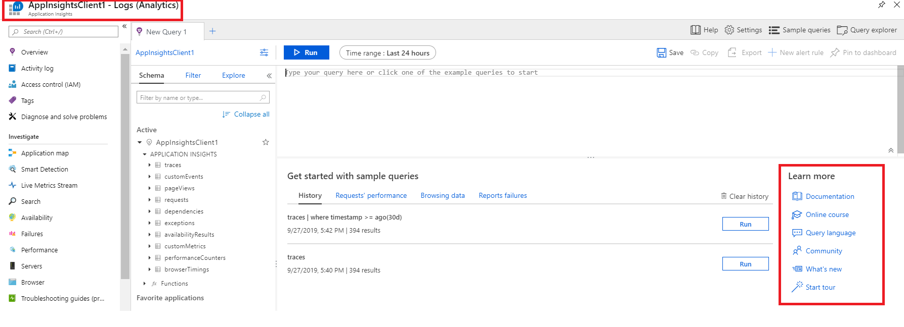
Kusto Query Language (KQL)

Slide 51
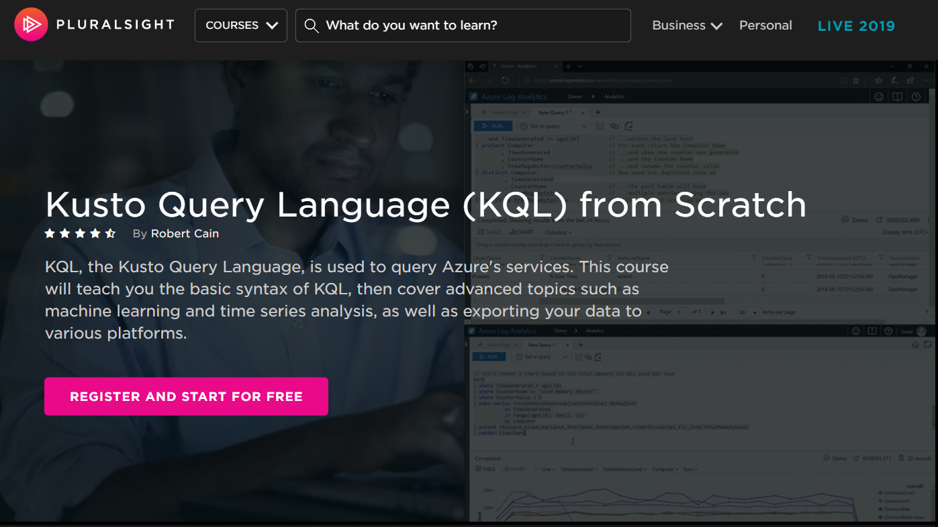
Notes:
Example query:
traces
| extend clienttype = tostring(customDimensions.['Client type'])
| where timestamp >= ago(30d)
| project timestamp, clienttype , customDimensions , AADTenantId=cloud_RoleName

Slide 52
Available signal
2019 release wave 2
Long Running SQL queries
Authorization
2020 release wave 1
Report execution
Web service calls
Cancelled operations
Update errors
Company lifecycle events
Database lock timeouts
Extension lifecycle events
Client telemetry (page views)
AL support (Session.LogMessage)
2020 release wave 2
Outgoing web service calls
ISV telemetry pipeline
ISV key vault
Long Running AL execution
Extension lifecycle (ISV)
AL sensitive field
Retention policy
Performance toolkit
Email module
Job Queue
Configuration packages
Permission lifecycle
CU3: Posting
CU3: web service key authentication
CU3: basic authentication
CU3: reporting engine added to reporting signal

Slide 53
How to give a third-party read-only access to telemetry
Grant read-only access to the resource https://github.com/microsoft/BCTech/blob/master/samples/AppInsights/FAQ.md#can-i-grant-read-only-access-to-application-insights
or
Generate API key for a Jupyter notebook TSG https://github.com/microsoft/BCTech/tree/master/samples/AppInsights/TroubleShootingGuides
In both cases, revoke access when they are done analyzing

Slide 54
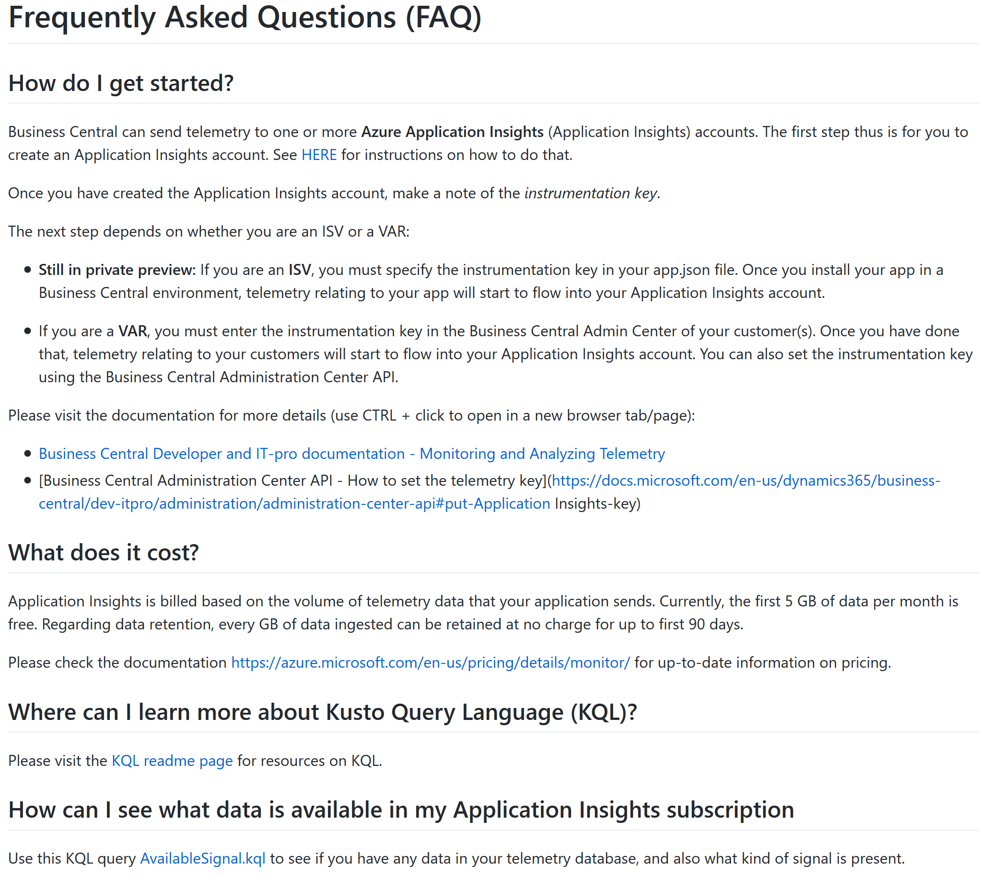
FAQ
Notes:
https://github.com/microsoft/BCTech/blob/master/samples/AppInsights/FAQ.md#frequently-asked-questions-faq

Slide 55
Links
About Azure Monitor/Application Insights
https://aka.ms/azuremonitor
Setup Business Central to emit telemetry to Azure Application Insights
https://aka.ms/bctelemetry
Telemetry signal overview
https://aka.ms/bctelemetry
Samples
https://aka.ms/bctelemetrysamples

Slide 56
Telemetry is just a fancy word for “usage data”
Data
Insights
Actions

Slide 57
aka.ms/bctelemetry

Slide 58
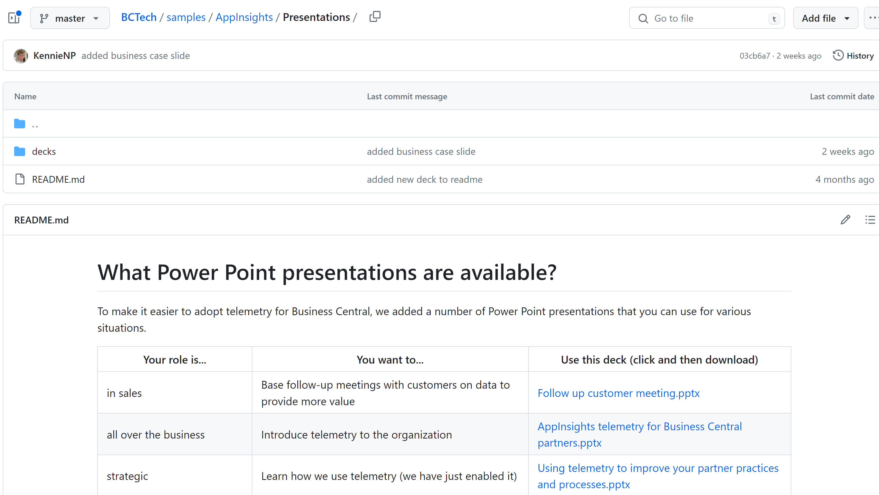
aka.ms/bctelemetrysamples

